Slide 1
2021 New Products
Overview

Slide 2
Sonatype now offers customers developer-friendly and full-spectrum control of the cloud-native software development lifecycle including:
third-party open source code (code you borrow) – Nexus Repository & Nexus IQ (Firewall and Lifecycle, ADP, ALP)
first-party source code (code you write) – Nexus Lift (Muse)
infrastructure as code (code you write to provision the cloud) - IaC Pack (Fuque)
containerized code (code you package to run in the cloud) - Nexus Container (NeuVector)
Notes:
Quick summary and overview of the current Nexus Platform.
We announced several technology partnerships and acquisition in the past couple of months to grow Nexus Platform offering.
Following form this - we have today's session dedicated Iac Pack!
For the code you borrow – Nexus Repo, Firewall, Lifecycle, ADP, ALP
For the code you write - Muse => It is developer-friendly source code analysis for GitHub, GitLab, and Bitbucket. Muse goes beyond traditional linting and SAST to perform deep code analysis, far exceeding legacy tools like SonarQube.
For the code you write to provision the cloud - IaC Pack => Empower developers to discover cloud security and compliance issues with IaC terraform analysis, giving development teams immediate feedback on cloud misconfigurations before they reach production.
For the code you package to run in the cloud - Nexus Container => you can protect containers and Kubernetes deployments on multiple cloud platforms. Nexus Container helps Development, Security, and Operations teams discover, continuously monitor, and fix container vulnerabilities and compliance issues during the entire container lifecycle.

Slide 3
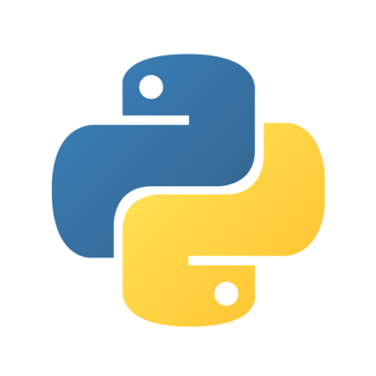
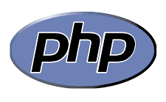
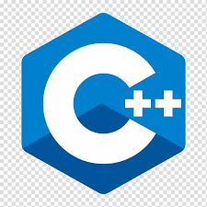
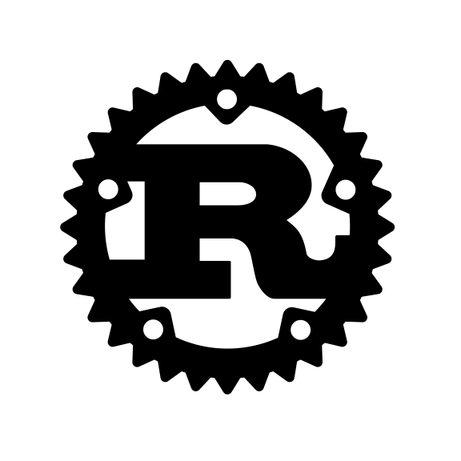
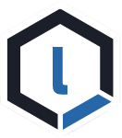
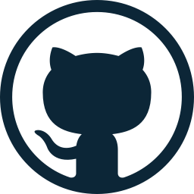
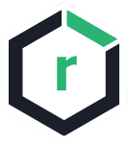
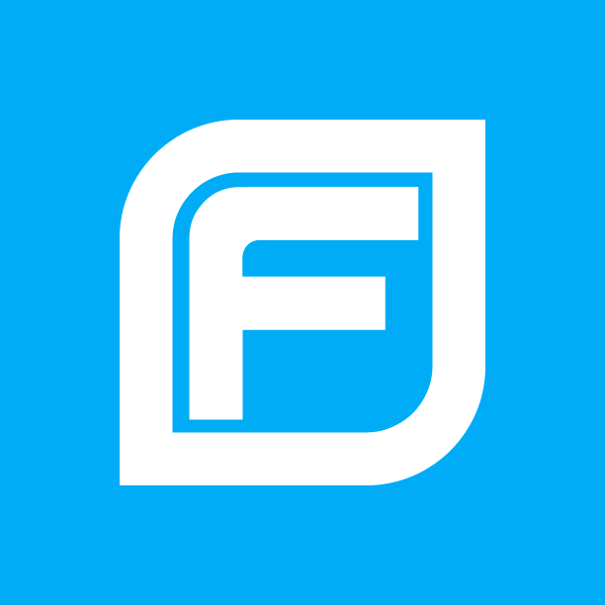
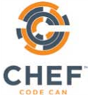
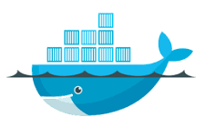
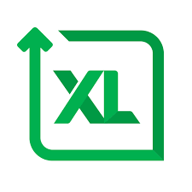
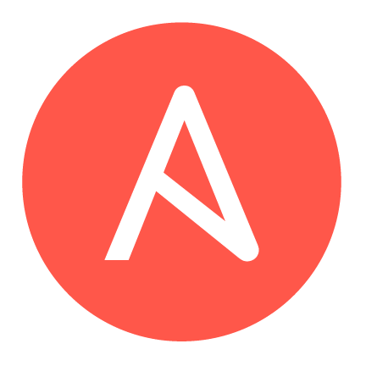
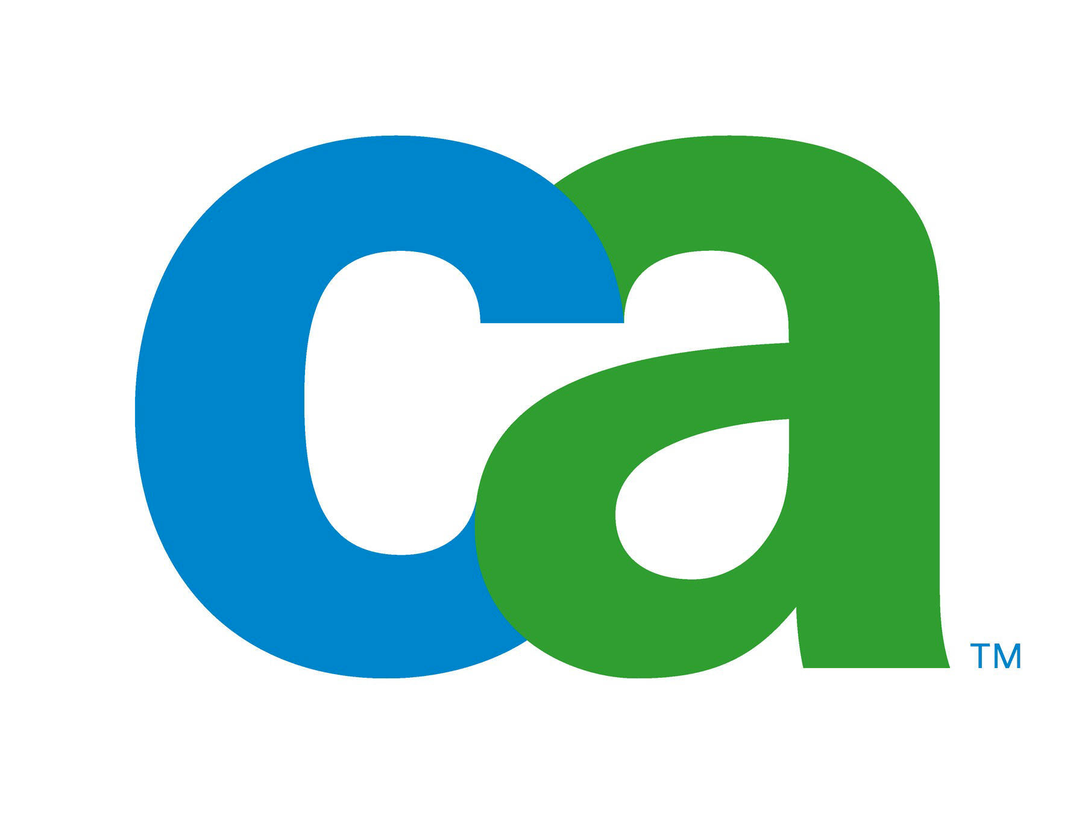
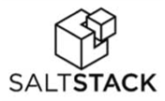
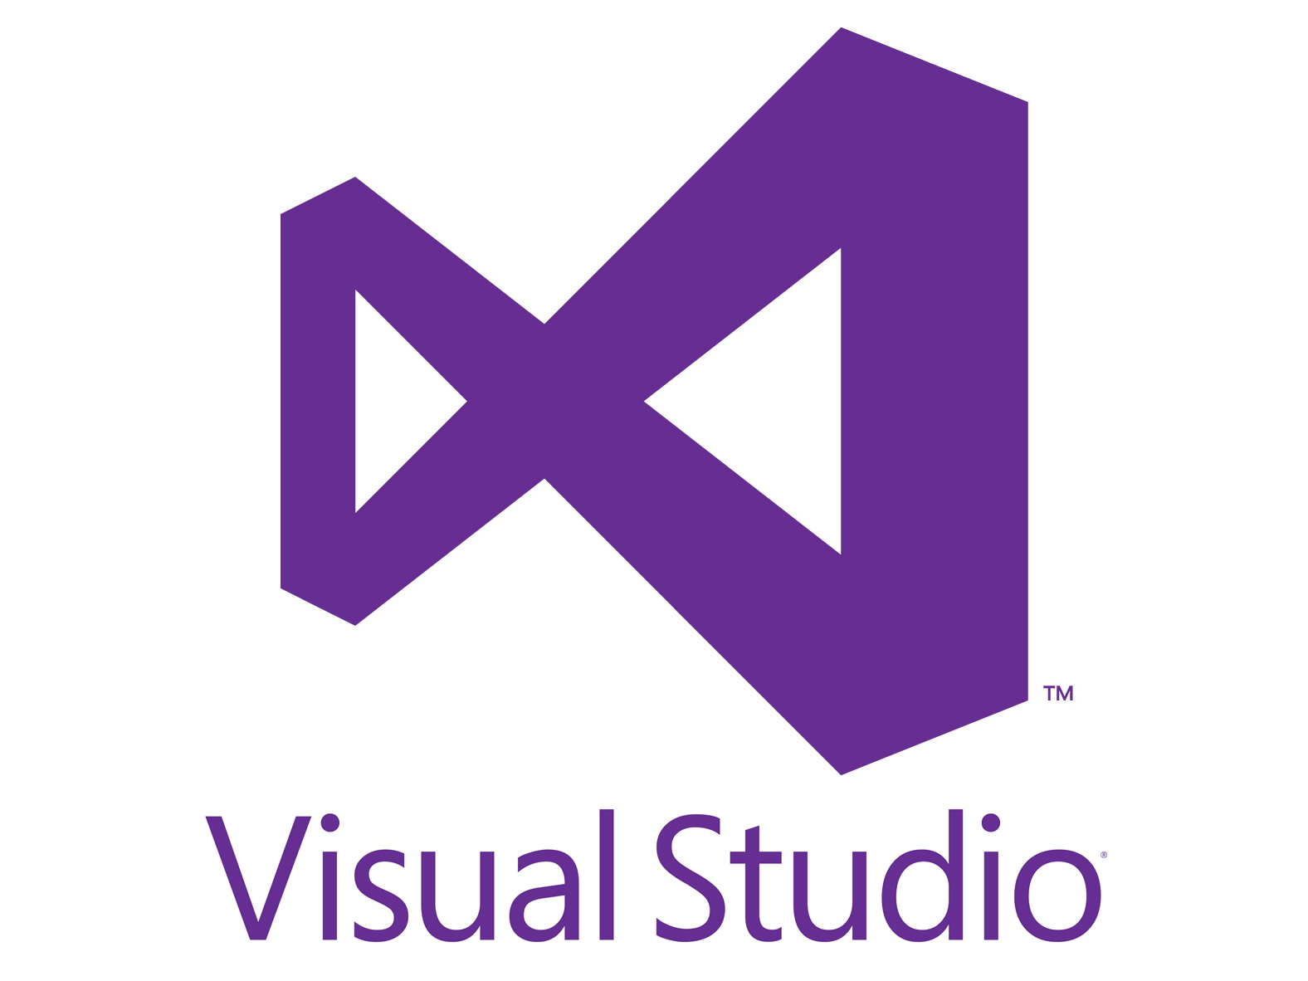
Nexus automatically enforces open-source policy and controls risk and integrates with your favorite pipeline tools across every phase of the SDLC .
Nexus Firewall
Automatically stop risk from entering SDLC.
Dev
Nexus Repository
Manage libraries and build artifacts.
QA
UAT
Source Control
Build
Repository
Release
Nexus Lifecycle
Continuously identify risk, enforce policy, and remediate violations across every phase of your SDLC.
Prod
Developers
Notes:
We want to unite software developers, security professionals, and IT operations on the same team and empower enterprises like yourselves to continuously identify and remediate risk, without of course slowing down innovation.
The Nexus Platform is a complete, integrated set of solutions designed to work together to enforce open-source policy and eliminate risk across every phase of your Software Development Lifecycle (SDLC).
Nexus Repository centrally stores and manages libraries and build artifacts across the entire SDLC.
Nexus Firewall automatically stops risk from entering the SDLC by enforcing policies when proxying to public repositories
Nexus Lifecycle works at every phase of the SDLC to continuously identify risk, enforce policies, and remediate violations, even within source control.
The entire solution works with your favorite DevOps tools out-of-the-box. No need for your development, security or Ops teams to learn a new tool. Our platform is uniquely architected to enforce policy and provide open source intelligence and remediation guidance right at your fingertips.
And while our solutions work well with Nexus Repository, we also support Artifactory environments with Firewall and Lifecycle. But, unlike Jfrog, we don’t force you to go to the Repo to enforce open source policy, we integrate open source governance wherever the app is located, in whatever tool is being used.

Slide 4
Advanced Development Pack
for
Notes:
The role of the developer continues to change as they sit on the front line of application.
Today, developers are focused on innovating fast and improving security.
The ADP functionality will put control back into the development teams' hands.

Slide 5
Advanced Development Pack Launch: Oct 7, 2020
Making Developer’s Lives Easier
Notes:
What it is
This is dependency management functionality for software developers that goes beyond just vulnerability identification and warnings.
A completely new add-on to Nexus Lifecycle to help teams improve code quality, minimize breaking changes, and integrate next-gen security.
We want to make Developer’s Lives Easier
Empower developers to make better decisions about third-party dependencies; the first time and forever (Breaking Changes, Transitive Solver, java only)
Help security protect against growing malware attacks targeting OSS supply chains (Release Integrity, npm only) – SOLARWINDS / DEPENDECY CONFUSION
SCM integration for faster onboarding and pull request feedback

Slide 6
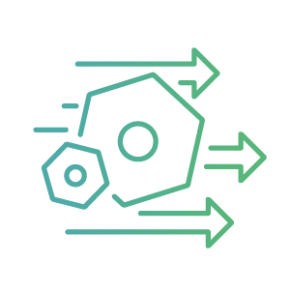
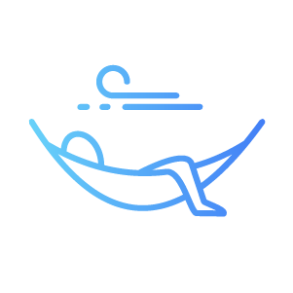
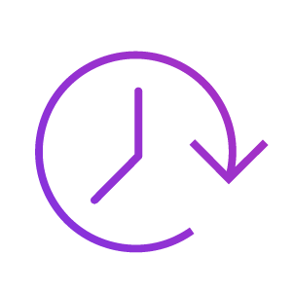
Benefits
Less rework and maintenance due to higher-quality “pool” of components and contextual understanding of what fits organizational requirements.
Decreased “Level of Effort” when upgrading to the next best OSS component with our recommendations and single click migrations.
Improved Project Quality with early warning of suspicious behavior in code and access to components from the best suppliers.
Increased Bandwidth and Time to Innovate due to reduction in time spent researching quality OSS components.
Notes:
With ADP development teams will now have ownership over the security of their projects and they will be able to develop with confidence and remediate security issues smoothly.
Developers will see the several key benefits:
Understand the purpose (and importance) of a component in your applications
Find alternatives to vulnerable components with no upgrade path
Replace old and crusty components with newer trustworthy ones
Make policies and decisions based on a component’s function
Choose components from vendors that use practices proven to produce the highest quality components

Slide 7
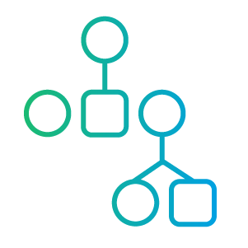
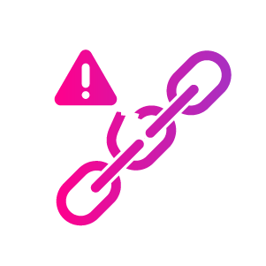
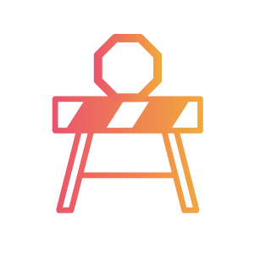
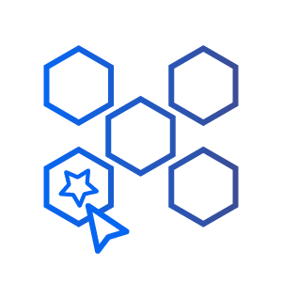
Develop Seamlessly
Make better decisions about components being used in the applications.
Fix Faster
We’ll suggest the best ways to resolve problems more effectively when they come up.
Transitive Solver
Breaking Changes
Release Integrity
Project Hygiene Rating
Component Chooser
Gives a recommended version for the direct dependency which also resolves the transitive dependency without violating policy or breaking builds.
Currently available in Maven ecosystems only
Provides teams with data on “what” will break & how much effort it’ll take to upgrade between current & newer versions.
Currently available in Maven ecosystems only
Enables development teams select the highest-quality OSS components for their projects. They can search and compare components based on hygiene ratings (exemplar, laggard, neutral), view additional component insights, and see what’s already being used/approved within their organization.
Currently in beta - to be released in Q3 2021.
Enhances Nexus Firewall’s capabilities to automatically detect & block suspicious and potentially malicious OSS components.
Next-generation software supply chain attacks: typosquatting and malicious code injection.
Currently available for npm ecosystems only
This first-of-its-kind system enables developers to select projects with the very best track records of release frequency, popularity, vulnerability remediation times, developer staffing, and other performance attributes. The exemplar, neutral, and laggard ratings assigned to each component were determined by a deep analysis of 30,000 OSS projects over a five-year period.
Currently available in Maven ecosystems only
Notes:
Let’s deep dive to all the new and cool features!
Transitive Solver - tackling a project’s overall risk and not just individual dependencies - it basically provides remediation advice for solving both direct and transitive dependencies (all without violating policies or failing builds).
Currently, with Nexus Lifecycle you can only update to “Next Version” with no policy violations or “Next Version” that does not fail a build that resolves for your direct dependencies. For transitive dependencies, you still have to do a lot of manual work going back and forth between scan reports and the slider to find and address transitive.
With the Transitive Solver we offer an upgrade path for problematic direct dependencies, as well as we address transitive dependencies so no more manual work – we put all dependency information in one place, making it much easier for you to resolve issues for both types of dependencies in one-click.
-----------------------------------------------------------------------------
Breaking Changes - in an industry first - enabling developers to instantly see which component version upgrades will require the least effort with the fewest breaking changes.
Without Breaking Changes, you have no visibility into remediation effort. While you are still able to take remediation actions, you can’t tell if it’s simply an upgrade to a newer version or if coding changes are required (more effort).
Breaking Changes helps by providing data on what will break if you move from your current to a newer version of an OSS component, as well as how much work it will take to complete that upgrade. This helps customers focus on the easiest way to address overall risk without having to spend hours on a fix.
-----------------------------------------------------------------------------
Release Integrity - a first-of-its-kind early warning system using Artificial Intelligence and Machine Learning to automatically identify and block next-generation software supply chain attacks relying on typosquatting and malicious code injection.
Without Release Integrity, customers can use Nexus Firewall as usual to block known bad components or those that do not fit organizational policy. They do not receive a risk score to write policy against or have insight into components that might be malicious.
Release Integrity adds a component risk score and ability to write policy against that, and view additional component integrity such as integrity rating, suspicious component classification, typosquatting remediation suggestions, rresearch status
-----------------------------------------------------------------------------
Project Hygiene Rating - this first-of-its-kind - health & hygiene rating system that helps developers quickly do a quality comparison of components without having to do their own research. When choosing a component to fit a need such as logging, this lets them consider the highest quality components within that category and avoid the lower quality ones.
-----------------------------------------------------------------------------
Component Chooser - think of this as Google for open source - it is an engine that will helps developers search and compare OSS components in order to select the highest quality options.

Slide 8
Demo

Slide 9
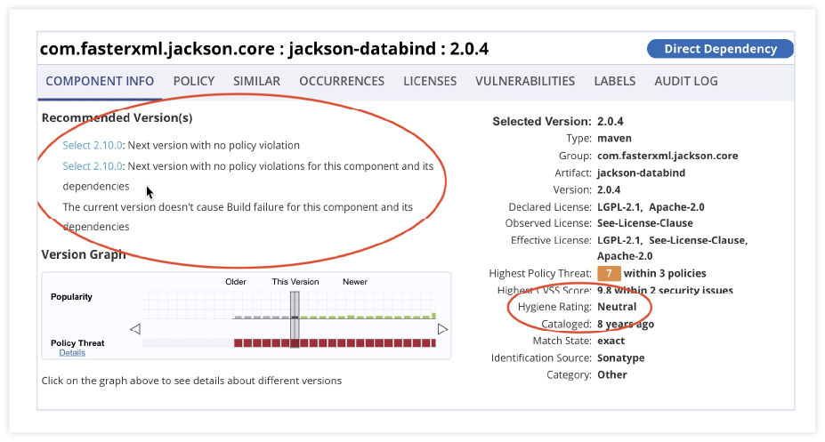
Transitive Solver
Easily solve for direct and transitive dependency violations without failing builds or violating policies.
One-click remediation and improved prioritization.
Comprehensive view into your open source risk profile.
Notes:
Transitive Solver - accessible in the Component Information Panel (CIP), we’re expanding dependency management to identify migration paths that solve for both the direct and transitive dependencies in a project without violating policies or failing builds. With the transitive risk identified, we provide comprehensive dependency management, ultimately addressing a project’s overall risk.
Customer Pain without the Advanced Development Pack
Currently, Nexus Lifecycle customers can only update to “Next Version” with no policy violations or “Next Version” that does not fail a build that resolves for their direct dependencies. For transitive dependencies, they have to do a lot of manual work going back and forth between scan reports and the CIP to find and address transitives.
How Transitive Solver Helps with Customer Pain
With the Transitive Solver, not only do we offer an upgrade path for problematic direct dependencies, but we take it a step further to address transitive dependencies. We automate manual work by putting all dependency information in one place, making it much easier for customers to resolve issues for both types of dependencies in one-click.
New strategies include
Next version with no policy violations no build failures with dependencies
Recommends the next version that won’t violate policy, without considering transitive dependencies that will not fail a build for this component and its dependencies.
Next version with no policy violations with dependencies
Recommends the next version of the component which does not have transitive dependencies that cause violations

Slide 10
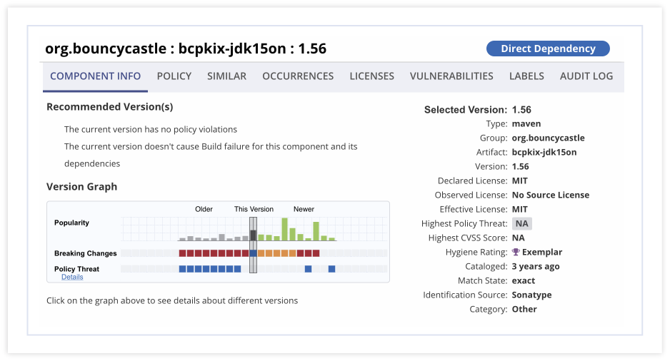
Breaking Changes Intelligence
Prioritize component upgrades by development effort.
Quickly find the best version upgrade without “breaking” the project.
Pinpoint simple upgrades and assess upgrade challenges.
Notes:
Breaking Changes - seen in the CIP’s version graph, users can move the graph to show them the best component to upgrade to without “breaking” the code in the project. We identify incompatibilities that exist within an upgrade path and then give the level of effort required to upgrade to that newer version.
Customer Pain without the Advanced Development Pack
Without Breaking Changes, customers have no visibility into remediation effort. While they are still able to take remediation actions, they can’t tell if it’s simply an upgrade to a newer version or if coding changes are required (more effort).
How Breaking Changes Helps with Customer Pain
Our capability pinpoints for our customers the “simplest” upgrades. We provide data on what will break if you move from your current to a newer version of an OSS component, as well as how much work it will take to complete that upgrade. This helps customers focus on the easiest way to address overall risk without having to spend hours on a fix.

Slide 11
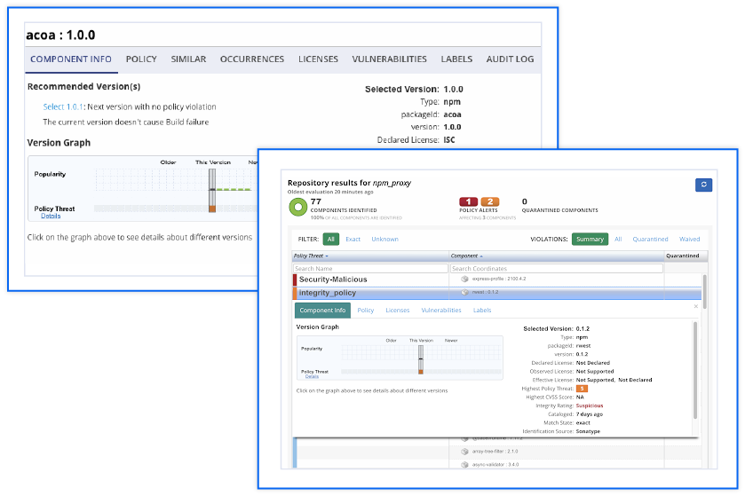
Release Integrity
Early warning and identification of next-gen software supply chain attacks (currently npm only).
Component risk score to assess level of risk you could take on by choosing that component.
Avoid threats like typosquatting and malicious code injection.
Release Integrity with Firewall.
Notes:
Release Integrity Intelligence - seen in the CIP via an Integrity Score and enabled via policy, this is an early warning system that identifies suspicious and potentially malicious components and blocks them before they entire production environments. Currently only available for npm and requires Nexus Firewall for full value.
Customer Pain without the Advanced Development Pack
Without Release Integrity, customers can use Firewall as usual to block known bad components or those that do not fit organizational policy. They do not receive a risk score to write policy against or have insight into components that might be malicious.
How Release Integrity Helps with Customer Pain
Release Integrity adds on to Firewall’s capabilities by providing a component risk score, ability to write policy against that, and view additional component integrity information including:
Integrity rating
Suspicious component classification
Typosquatting remediation suggestions
Research status
Integrity levels
Normal - Nothing appears out of the ordinary compared to other releases in this project or other projects in this ecosystem
Abnormal - This release is out of the ordinary and shows patterns of behavior that might indicate malicious intent or increased chance of risk.

Slide 12
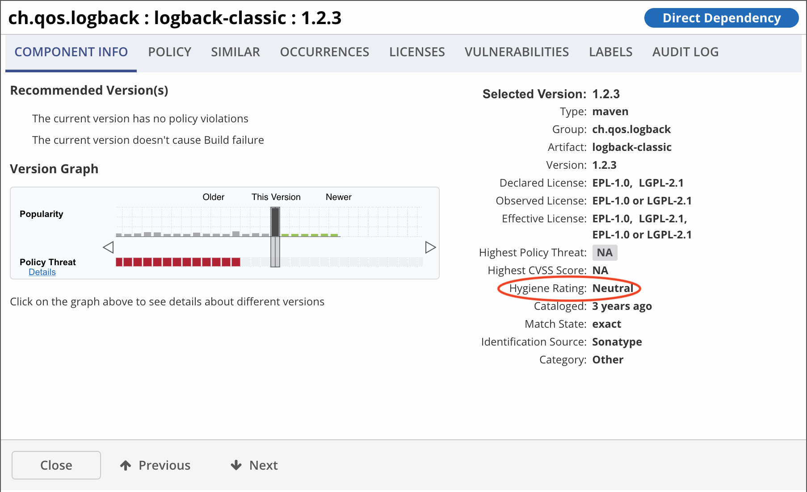
Showing You Only the Best OSS Components
Health & Hygiene Data
Easily compare the viability of different components based on their rating.
Ratings include:
Exemplar
Neutral
Laggard
Select the best quality components based on component cleanliness, committer behavior, etc.
Notes:
When choosing a component to fit a need such as logging, this lets them consider the highest quality components within that category and avoid the lower quality ones.

Slide 13
Advanced Legal Pack
for

Slide 14
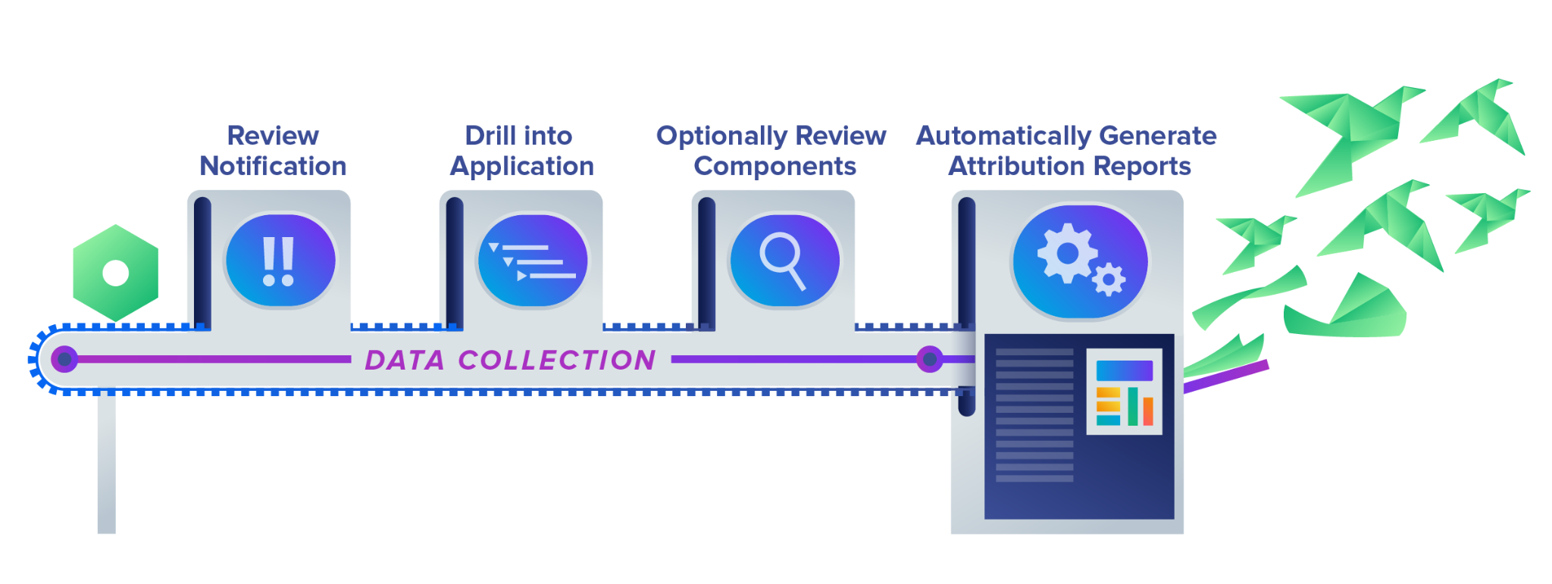
Meet the Advanced Legal Pack
The fastest and most reliable way to automate legal compliance, identify and understand OSS license obligations, and eliminate overall regulatory risk.
Notes:
The Advanced Legal Pack is an add-on to Nexus Lifecycle that helps Legal teams and Developers manage OSS license compliance by automating manual tasks and providing legal workflows for easier and faster obligation resolution.
This add-on to Lifecycle is perfect for organizations that:
Need a legal review process
Want to offload manual work
Are looking to fulfill OSS license obligations instead of just blocking non-compliant components through policy

Slide 15
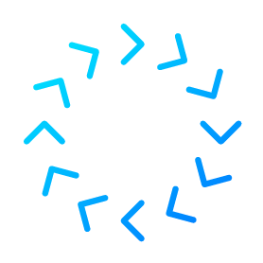
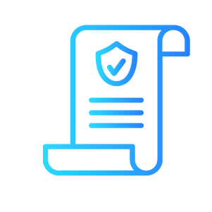
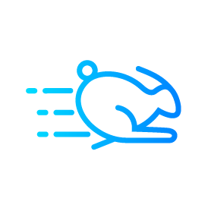
Per Component OSS Legal Compliance in 30 Seconds or less
Eliminate manual work with automation
Automate the collection of legal data, compliance workflows, and attribution reports.
Comply with standards & regulations
Certain industry standards, like OpenChain, require obligation management or cloud marketplaces requirements.
Access the industry’s most comprehensive legal data
Not all data is sufficient for full legal compliance. Our extended data includes copyright notes, texts, and more.
Expedite release frequency
Start reviewing legal data as far left into the SDLC as possible. With our automation, you no longer need to wait for someone to manually collect that data.
Notes:
ALP functionality offers legal teams the fastest and most accurate way to manage OSS license obligations and speed up legal compliance.
This is the fastest and most reliable way to automate legal compliance, identify and understand OSS license obligations, and eliminate overall regulatory risk.
ALP will
Automate attribution reports: painful and manual work now done as part of Dev!
Legal Team will see the entire licensing landscape so they can understand all copyright notices, and license text
Automatically resolve license obligations: Per component, per license

Slide 16
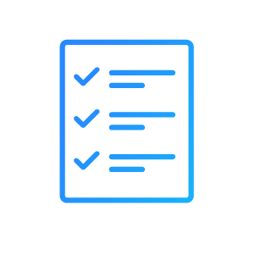
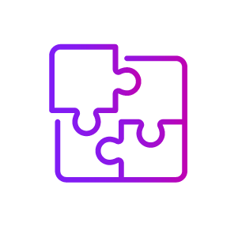
Capability Overview
Legal Compliance Workflow
Examine auto-collected extended legal data and address legal obligations with our check-list of actionable tasks - all from your Nexus Lifecycle dashboard. Fulfilled obligations can be saved at the global, organization, or application level so that future uses of that component can benefit from that review.
Attribution Reports
Auto-generate third party notice texts or attribution reports and save for later use.
Extended Legal Data
In-depth data including notice texts, license texts, and copyright statements are required to be preserved or attributed in many liberal licenses.
License Obligation Review Tool
A succinct list of license obligations and where it can be found in the license text.
Notes:
The tool will provide:
Transparency into binding open source licencing requirements before, during and after the software development process.
Avoiding copyright infringement by understanding "copyleft" legal obligations within third-party code.
Having a full Software Bill of Materials (SBOM) for shipped applications to prove third-party licensing obligations and copyright requirements.

Slide 17
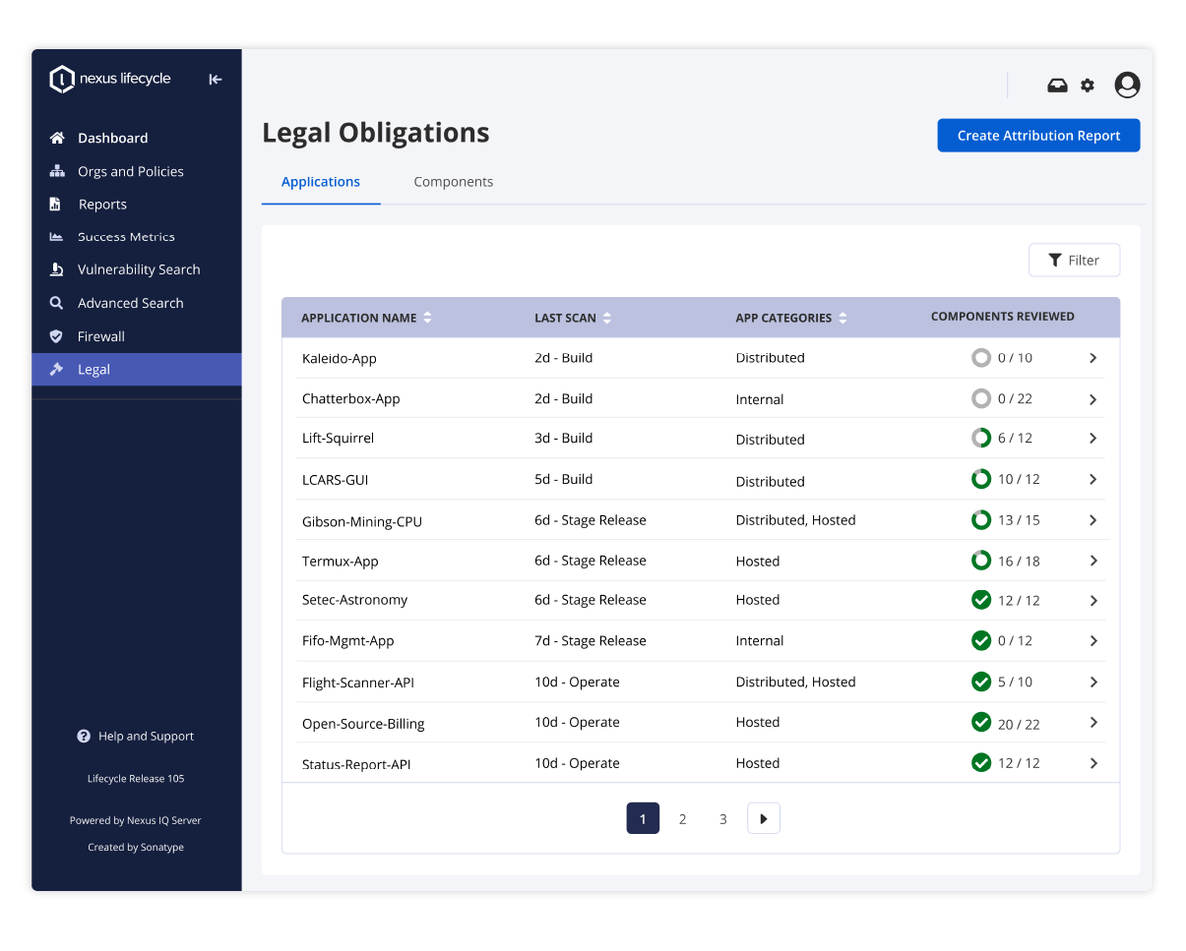
ALP at a Glance - Dashboard View
All legal data viewed here is automatically identified and compiled by our internal systems
High-level view of license issues to determine which obligations have been met and fulfilled
Access workflows that guide legal teams through obligations, copyright, and other requirements
Notes:
Dashboard view to quickly determine which obligations have already been met and fulfilled
AI/ML automatically identify every OSS component license used in an application build
Legal obligations for every OSS license are shared with the legal department.
Automated workflows guide legal teams through obligations, copyright and other requirements
Once all obligations are met, approvals documented and a record of the review is kept for auditors.
In cases where legal risks an deemed unacceptable, information is shared on alternative less risky component choices for developers.
Advanced Legal Pack integrates with existing Nexus Lifecycle implementations.

Slide 18
Demo
Notes:
Building on the robust features available in Nexus Lifecycle, ALP adds the following capabilities:

Slide 19
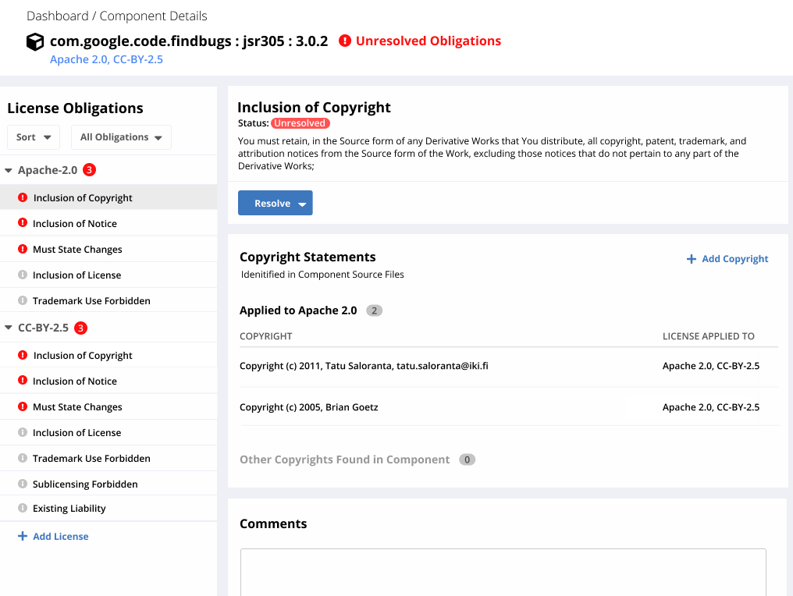
Legal Compliance
Workflow
Each component and license gets an obligation workflow with a checklist of actionable tasks to resolve an issue
Quickly determine which obligations have been met and fulfilled
Reduced back-and-forth interactions between legal and developers
Extended legal data is seamlessly integrated into these workflows
Notes:
Legal Compliance Workflow - Accessible from the new Legal tab, our machines automatically identify every OSS component license used in an application build and displays those in a dashboard view. From there, we provide workflows consisting of a checklist of actionable tasks needed to resolve obligation issues. Save license obligation resolutions (per component, per license) to reuse in the future.

Slide 20
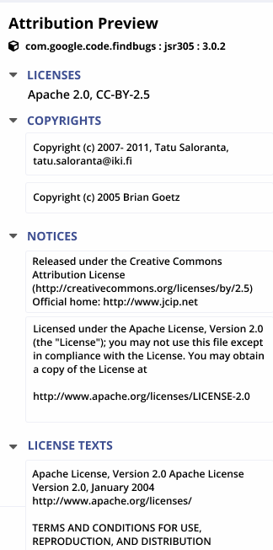
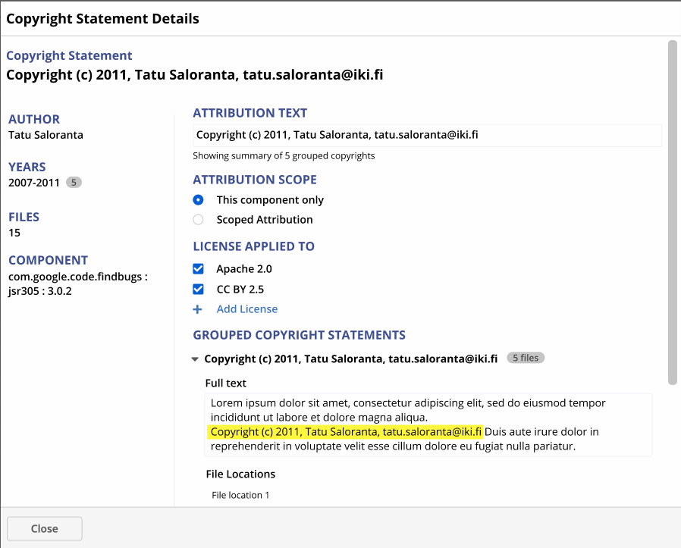
Automated Attribution Reports
Save attributions per component and auto-generate reports to comply with OSS obligations
Save reviewed and approved obligation resolutions so that any re-use of that component within the organization will reflect that resolution
Customize and edit reports as needed
Notes:
Automated Attribution Reports/Third-Party Notices - Automated data collection and generation of attribution reports that comply with 90+% of OSS obligations. Save, customize, and edit reports as needed.

Slide 21
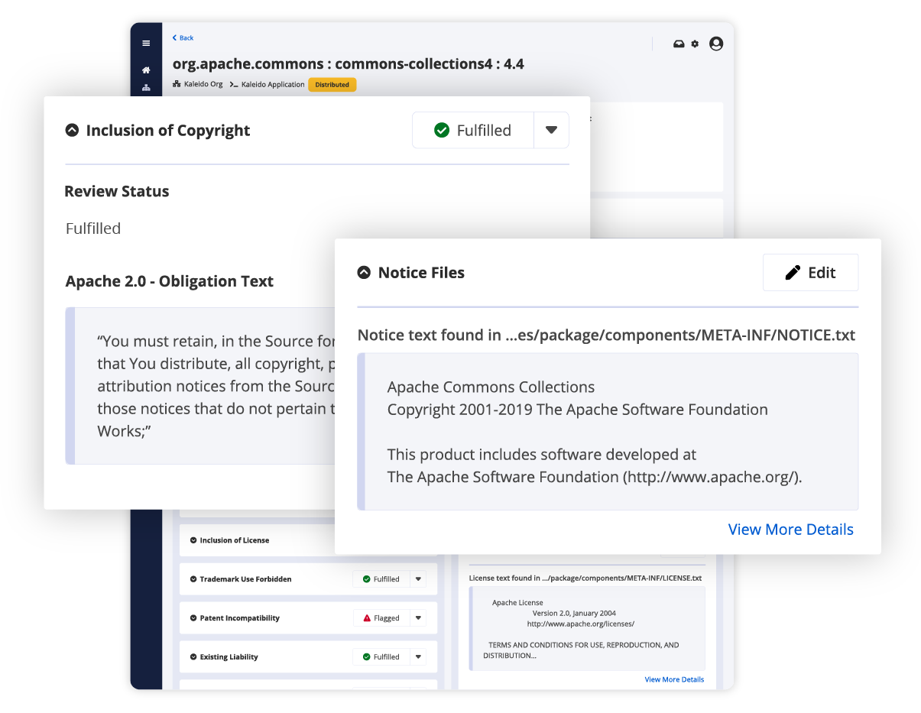
Deep Legal Data You Care About
Easily search for a component in our backlog and export that data and additional instructions on how to best comply with an obligation
Detailed information that is necessary to fulfill obligations like copyrights, notices, and full license text
Backed by Sonatype machine-learning algorithms and natural language processing
Notes:
Extended Legal Data - Our machine learning algorithm and natural language processing detect legal data and integrate it into our legal compliance workflows. This includes more than just license detections to cover copyright statements, all notice statements, and all license texts found in a component. All legal data collection is automated.

Slide 22
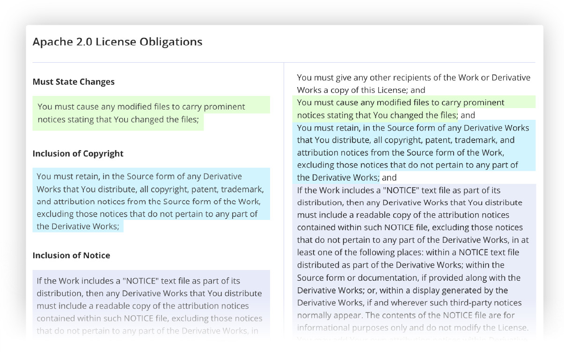
License Obligation Review Tool (LORT)
Look up licenses and view the annotated license text, highlighting the license obligations
Comprehend the thousands of licenses and their obligations so you can set policies that will drive automation
Succinct list of licenses to understand what is being used by your components
Notes:
LORT - An extensive database of open source license obligations across multiple categories, types, and threat groups that is continuously updated by the Sonatype Data Research team. We provide a succinct list of all licenses being used by a component, allowing them to read through obligations and easily look up licenses, view annotated license texts, and export lists. The value here is a succinct list of license’s legal obligations so customers can understand how we categorize licenses in our reference policy and to also make their own decisions with regards to license policies.
LORT is now a feature of ALP

Slide 23
Infrastructure-as-Code Pack
for

Slide 24
Your Current State & Business Goals
Where is your organization today in its cloud journey?
How strategic is public cloud for your organization?
Which Cloud Providers are you using? AWS, others?
How are you deploying cloud infrastructure?
Using Terraform?
Which compliance standards apply to your organization?
CIS Benchmarks, CIS Controls, GDPR, ISO 27001, NIST 800-53, PCI, SOC 2 etc
How are you addressing run-time cloud infrastructure security today?
Native tools, 3rd Party?
Notes:
Where is your organization today in its cloud journey?
How strategic is public cloud for your organization? Which Cloud Providers are you using? AWS, Azure, GCP?
Is your team or organization using Infrastructure as Code? Are they using IaC templates? If not, are they using the cloud console?
How are you deploying cloud infrastructure? Using Terraform?
Which compliance standards apply to your organization? CIS Benchmark, Soc 2, GDPR, ISO 27001, NIST 800-53, PCI DSS?
Are you using a tool to check that your IaC is compliant and not leaving you open to risk? If not, how do you know your cloud infrastructure is secure? How do you stay compliant? If yes, do you know which one?
How are you addressing run-time cloud infrastructure security today? Native tools, 3rd Party?

Slide 25
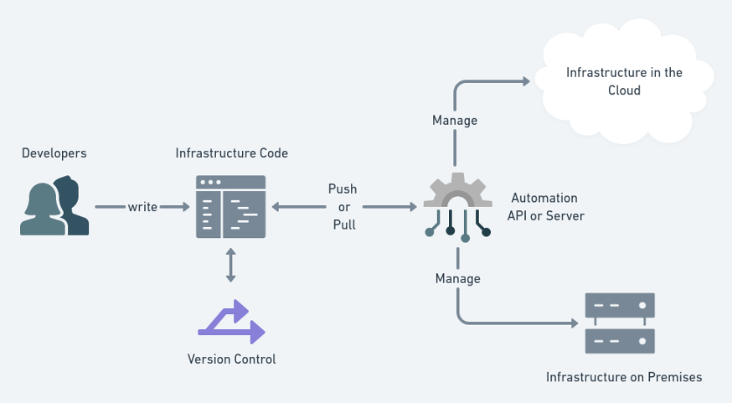
What is Infrastructure as Code?
Infrastructure as code (IaC) is the process of managing and provisioning computer data centers through machine-readable definition files, rather than physical hardware configuration or interactive configuration tools.
Notes:
What is Infrastructure as Code?
Development and deployment are moving to the cloud.
Developers are being tasked with a wider breadth of tasks in their day-to-day responsibilities, including building their own cloud infrastructure.
Similar to choosing and configuring the right open-source components, developers now own the process of writing code to provision and configure their cloud infrastructure.

Slide 26
Why IaC Analysis?
Move fast and more securely
Code-based infrastructure configuration reduces the error-prone aspect of manual provisioning, creates consistency, and increases speed and productivity.
However, infrastructure as code templates can be full of misconfigurations and vulnerabilities, such as unencrypted databases, no logging enabled, and over privileged or insecure instances that leave them open for attack.
Compliance is a huge issue for highly regulated companies including meeting standards like GDPR, HIPAA, ISO 27001, NIST 800-53, PCI DSS, and SOC2 etc.
Notes:
Instead of having to wait on other teams, infrastructure automation tools save a lot of time and are scalable, but inherently come with serious risks.
The number one cause of cloud data breaches is misconfiguration.
Therefore, developers need tools to help them to catch misconfigurations and policy violations early, before they reach production, to ensure their cloud infrastructure is secure, safe from hackers and data breaches, and compliant with the latest industry standards.
Every major industry has compliance standards, including controls for cloud infrastructure. There are hundreds if not thousands of security rules that apply to cloud infrastructure configuration. Those rules map to compliance standards. This is a very intensive, time consuming process that our Partner Fugue has already done, and the IaC Pack provides out-of-the-box support for number of compliance standards

Slide 27
What is Terraform?
Terraform is the most popular universal IaC tool with ~80% market share
Terraform can be used to build and manage cloud infrastructure across multiple platforms including:
Microsoft Azure
Amazon Web Services (AWS)
Google Cloud Platform (GCP)
Each cloud provider also offers their own IaC tooling:
Azure - Resource Manager
AWS - CloudFormation - Support for CloudFormation is coming soon for IaC Pack.
GCP - Google Deployment Manager - GCP is not currently supported but is also on the roadmap for later in 2021.
Notes:
The most popular IaC tool is Terraform (~80% market share).
Terraform is a universal tool and can be used to build and manage cloud infrastructure across multiple platforms including Amazon Web Services (AWS), Microsoft Azure, and Google Cloud Platform (GCP).
It’s also popular for Kubernetes, private cloud infrastructure, and can be used for almost anything with an API.

Slide 28
“
“Nearly all successful attacks on cloud services are the result of customer misconfiguration, mismanagement and mistakes.”
— Neil MacDonald, Gartner
“Through 2025, 90% of the organizations that fail to control public cloud use will inappropriately share sensitive data.”
— Gartner
“By 2023, 60% of organizations will use infrastructure automation tools as part of their DevOps toolchains, improving application deployment efficiency by 25%.”
— Gartner
Notes:
According to Gartner, cloud misconfiguration is the number one cause of cloud-based data breaches.
Cloud deployment comes with a few inherent risks, and even using the cloud console leaves opportunity for misconfigurations.

Slide 29
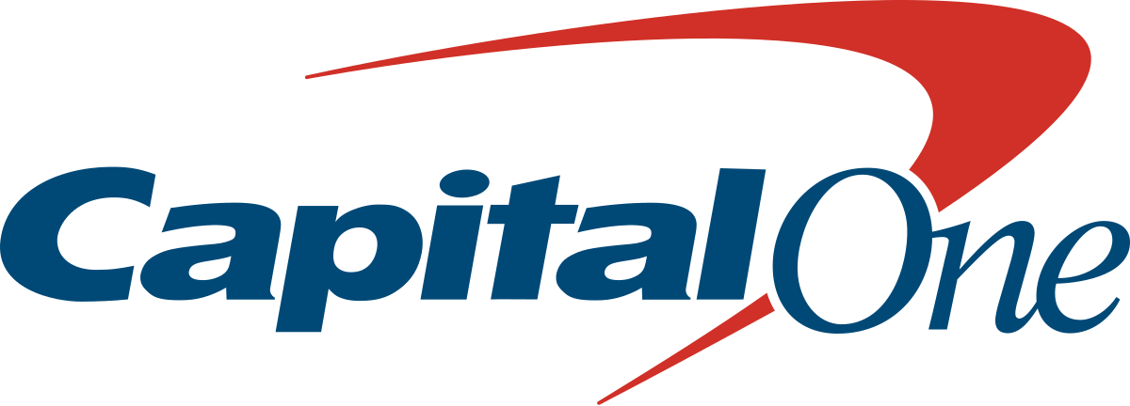
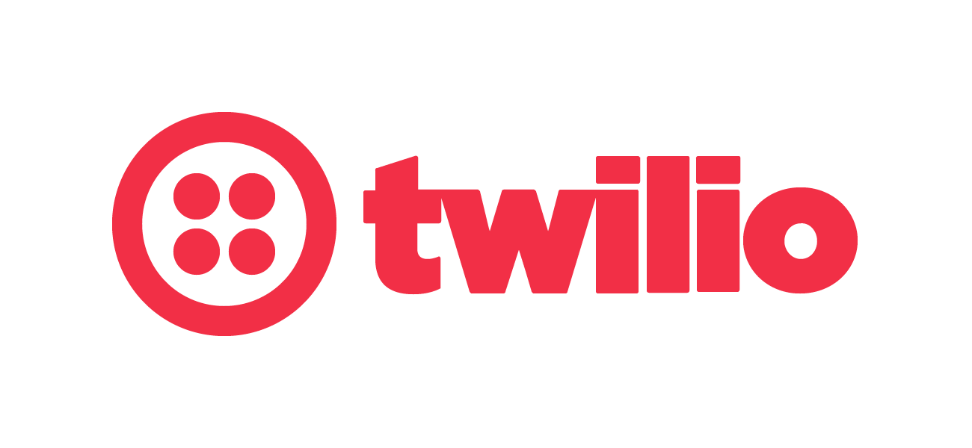
Cloud misconfigurations are the number one cause of cloud-based data breaches!
The Capital One breach was caused by a firewall left inadvertently open to the Internet, along with an overprivileged EC2 instance role
The Magecart group backdoored Twilio’s SDK which was hosted on a world-writable S3 bucket
The Los Angeles Times website started mining cryptocurrency in your browser due to a world-writable S3 bucket
Notes:
Recent cloud data breaches: CapitalOne, Twilio, LA Times
Key takeaway he is misconfigurations are preventable.
Capital one breach:
Firewall misconfiguration gave hacker access to a box that was meaningless, they were able to work from there to gain more access - was able to list all the S3 Asset - found some good things to steal - was able to get a list of IM (Identity Management) roles - was able to assume a IM role with permissions - finally was able to use those permissions to recreate the S3 buckets in their account, and copy over the data

Slide 30
What is the IaC Pack?
The Infrastructure as Code Pack
The Infrastructure as Code Pack is a completely new add-on to Nexus Lifecycle that helps developers find cloud security and compliance issues related to writing Infrastructure as Code (IaC), giving them early feedback on cloud misconfigurations before they surface in production.
Notes:
This NEW Infrastructure as Code Pack is an add on to Nexus IQ/ Lifecycle (similar to ADP), and enables developers to check their cloud infrastructure as code templates for vulnerabilities or misconfigurations before releasing to production. They can catch issues in Terraform before deploying to production.
With IQ and IaP Pack you can ensure that both your applications and the cloud infrastructure you are running on, are safe and compliant.
-----
Sonatype partnered with Fugue to provide a powerful centralized control panel for Infrastructure as Code (IaC) and application layer protection.
Sonatype secure what you build and Fague secure where you run it!
It is not a full cloud infrastructure runtime solution to check for changes and maintain compliance. Interested customers will be referred to Fugue.

Slide 31
IaC ROI
ROI on Pre-Deployment Checks for IaC
Developing and maintaining rulesets that catch security and compliance-relevant misconfigurations.
Few hours to several days
Minutes
Mapping rules to common compliance standards (e.g. PCI, SOC 2 Trust Services Criteria, etc.)
2 weeks +
Minutes
Reporting and notifications on compliance violations
Several days
Minutes
Notes:
With The IaC Pack, we’re able to give developers early feedback, and catch compliance issues and misconfigurations within minutes before the infrastructure is deployed to production.

Slide 32
Demo

Slide 33
How the IaC Pack works
Sonatype will provide guardrails and guidance for devs configuring their IaC.
A resolved Terraform plan file named *.tfplan
To scan a Terraform plan file - the first step is to generate it. This is typically done using the terraform plan -out=terraform.plan command during the build process. terraform show -json terraform.plan > terraform.tfplan
Executing a scan via the CLI, Web UI, or as a build step with Jenkins will automatically search for files with the extension .tfplan and include the results as part of the application scan.
Run the Nexus IQ CLI: java -jar nexus-iq-cli-1.105.0-SNAPSHOT.jar -i test-app -s http://localhost:8070 -a admin:admin123 -t develop .

Slide 34
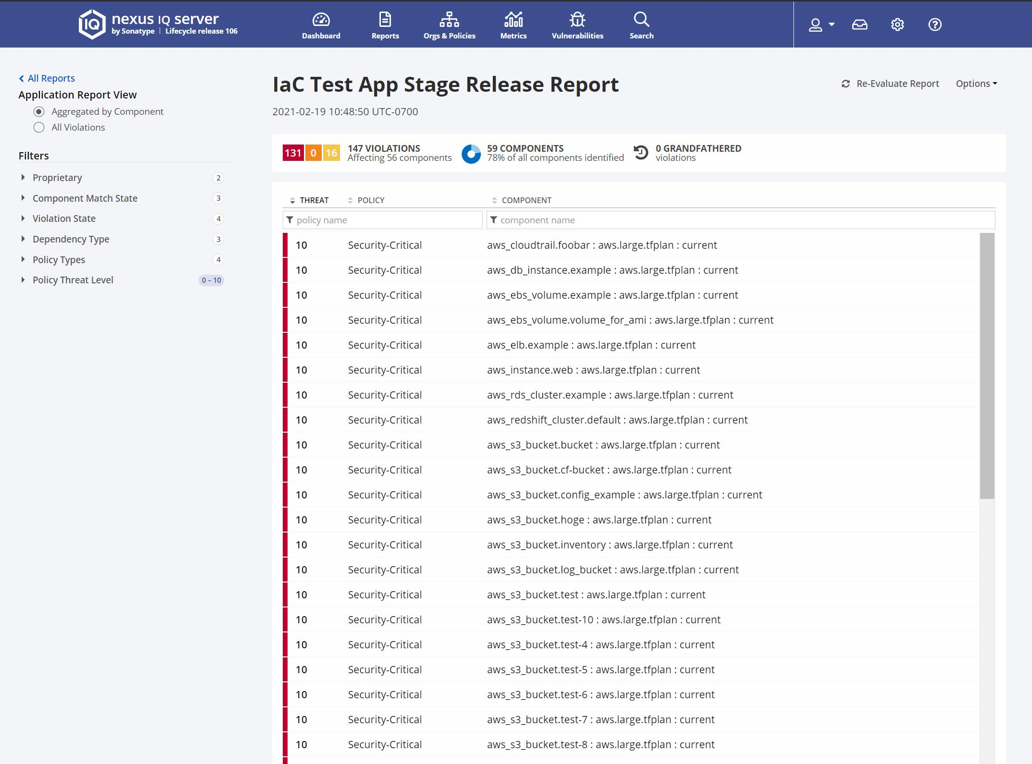
Nexus Lifecycle View
Infrastructure violations are shown in the Nexus IQ report alongside open source vulnerabilities!

Slide 35
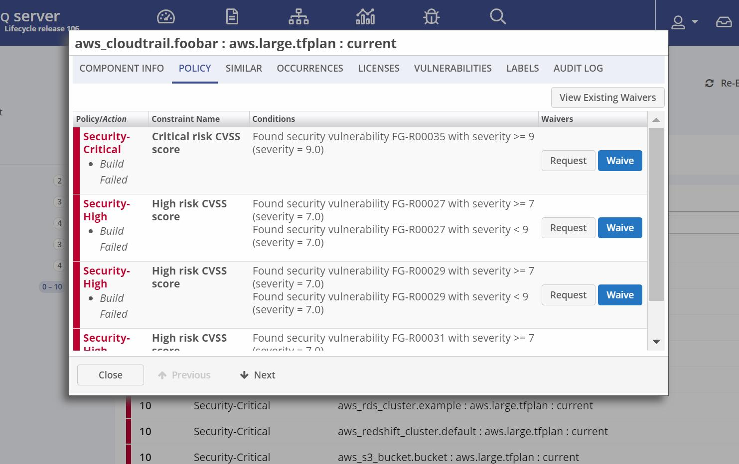
Nexus Lifecycle View
Just like an open source vulnerability, we provide deep insights into the severity and root cause.

Slide 36
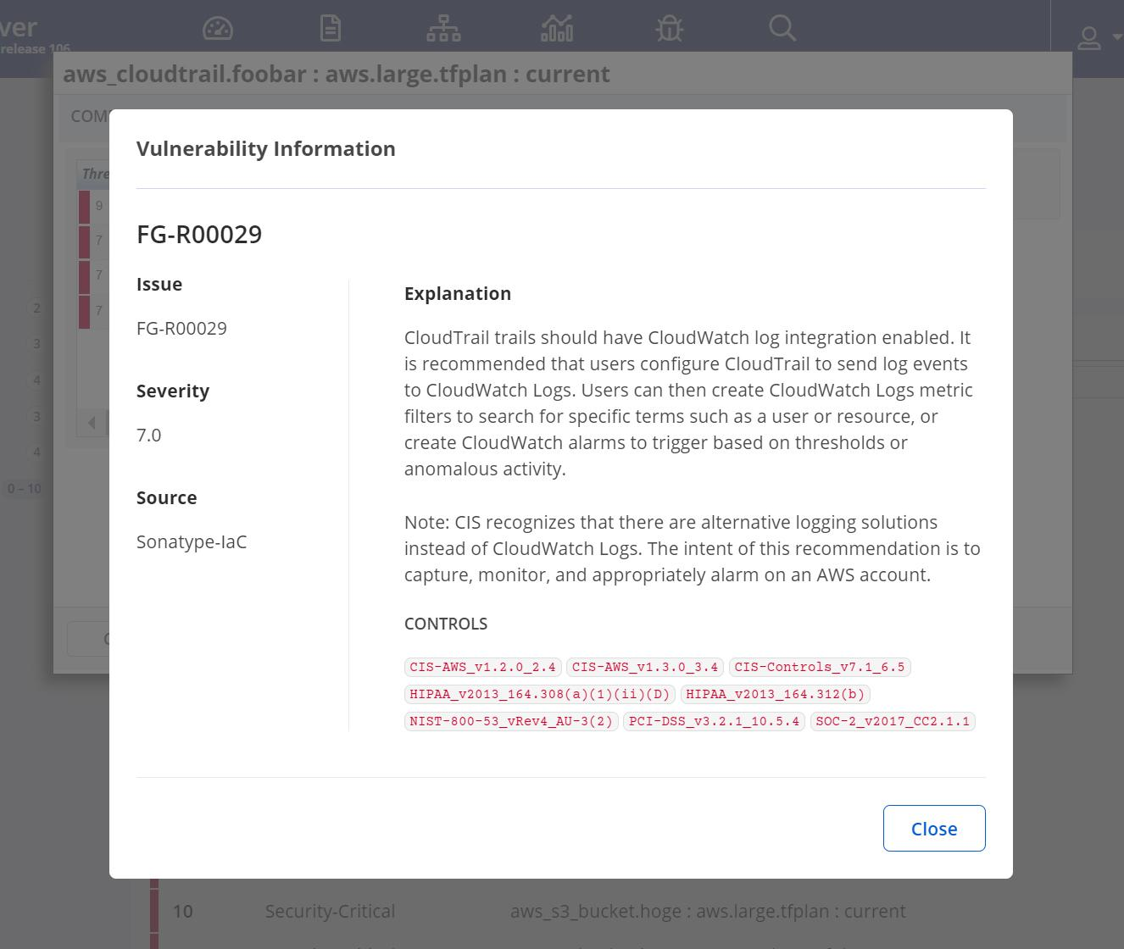
Nexus Lifecycle View
Leveraging new infrastructure and compliance data, we can give remediation guidance and pinpoint the specific compliance rules that are impacted.

Slide 37
Notes:
Sonatype partnered with NeuVector to provide best-of-breed container security to help our customers find and fix container vulnerabilities and compliance issues from build to ship to run.
Full Lifecycle Container Security from Dev to Production to protect containers and Kubernetes deployments on multiple cloud platforms.

Slide 38
What is your current set up/ process for container deployments and analysis, challenges, priorities, expectations?
Are you running containerized environments? (Kubernetes, OpenShift, Rancher, Docker, etc.)
Do you deploy applications and services to a K8S cluster?
Who has responsibility for runtime management of the K8S clusters?
Who has responsibility for ensuring the container that you deploy into your K8S cluster are secure?
Would you find value in integrating both application and container analysis as part of your pipeline?
How do you manage the network security risks between production containers in your K8S cluster and do you have visibility?
Your Current State & Business Goals

Slide 39
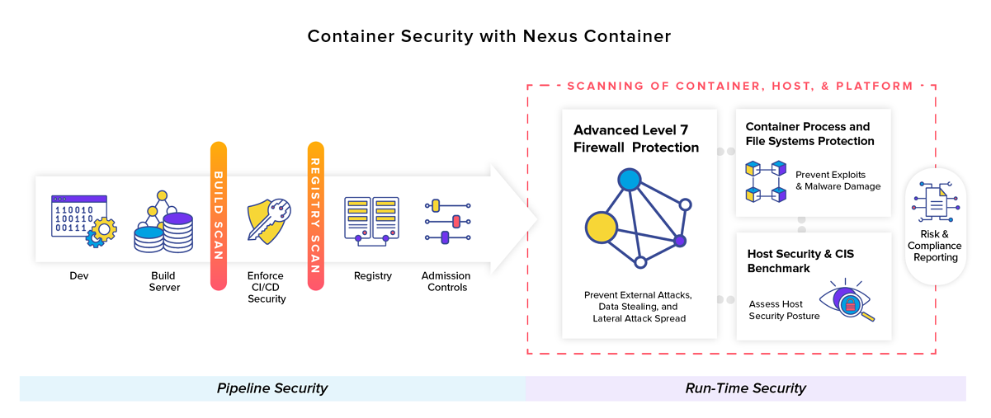
Launch: March 3, 2021
Nexus Container is a single container offering that provides continuous, deep visibility and vulnerability insight into both the runtime and dev layers during build/registry and in production.
Notes:
What it is
Nexus Container is a Kubernetes-native container security solution to protect containers, registries, and run-time workloads with end-to-end vulnerability management and compliance.
Nexus Container integrates directly with your Jenkins plugin to scan during build, monitor images in registries, and run automated tests for security compliance, as well as protect deployed containers from zero-day and application attacks like DDoS and DNS, in real time.
Our run-time behavioral inspection identifies all network traffic at Layer 7 and every container process to automatically create behavior-based security policies, enforce Data Loss Protection, and prevent zero-day malware and network attacks, tunnel, breaches, etc.
For the first iteration, this is NeuVector’s platform branded as a Sonatype - Nexus Container product and “powered by NeuVector.”
In the future it will integrate with Nexus Lifecycle to report findings.
Nexus Container Advantage
Combines behavioural learning with deep packet inspection to create zero-trust environments
Deploys as a container (Kubernetes)-native platform to offer security at the speed of DevOps.
Business objectives:
Nexus Container is a container security solution to provide continuous, deep visibility and vulnerability insight and to build a unique and valuable experience for organizations which are looking to put container security in the hands of DevSecOps professionals.

Slide 40
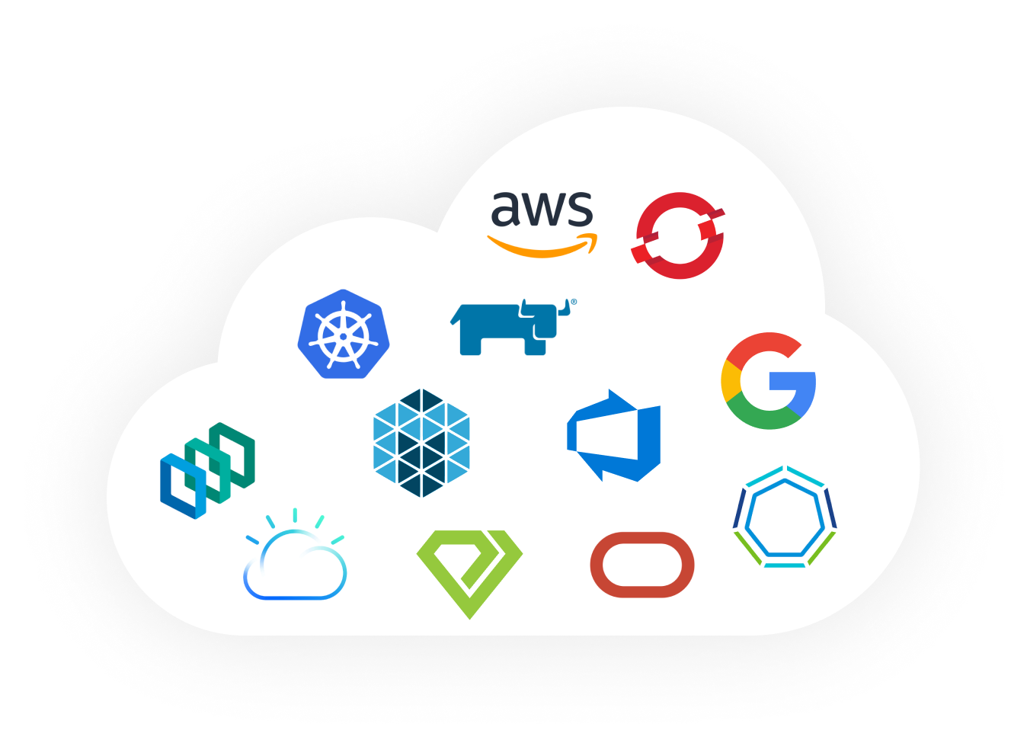
A Cloud and Kubernetes native platform
that integrates seamlessly
Notes:
Nexus Container is a Cloud and Kubernetes native platform that integrates seamlessly.

Slide 41
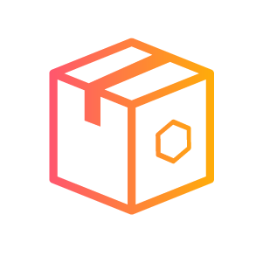
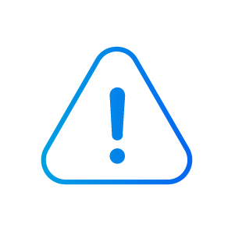
Why Nexus Container?
The most comprehensive solution for securing containers throughout the entire container life cycle.
End-to-End
container security
Vulnerability and compliance scanning for misconfigurations, security assessments, and admission control throughout the CI/CD pipeline
Unmatched run-time protection
Only solution with Data Loss Prevention (DLP) and can actively protect against vulnerability exploits, zero-day attacks, malware, and insider attacks.
Protection without performance issues
Our solution deploys as a container. No sidecars, agents, or code changes necessary.
Create a zero-trust environment
Identify, alert on, and block any anomalous behavior and automatically generate security policies
Notes:
Customers turn to Nexus Container when they realize that all the scanning and host security precautions still leave them vulnerable to zero-day attacks while in production.
Ability to see, validate, and create security policies from network and process traffic within Kubernetes Clusters
Behavioural learning analyses application processes and Layer 7 (L7) to automatically generate security policies (security-as-code). This helps establish a real source of truth, eliminating false positives and creating visibility into all container activity, whether defined or not
Proprietary technology and architecture allows Nexus Container to run at line speeds without hindering performance
Provides Data Loss Prevention (DLP) in containerized environments, preventing sensitive and regulated information from escaping the customer’s environment (PII, credit card data, etc.)

Slide 42
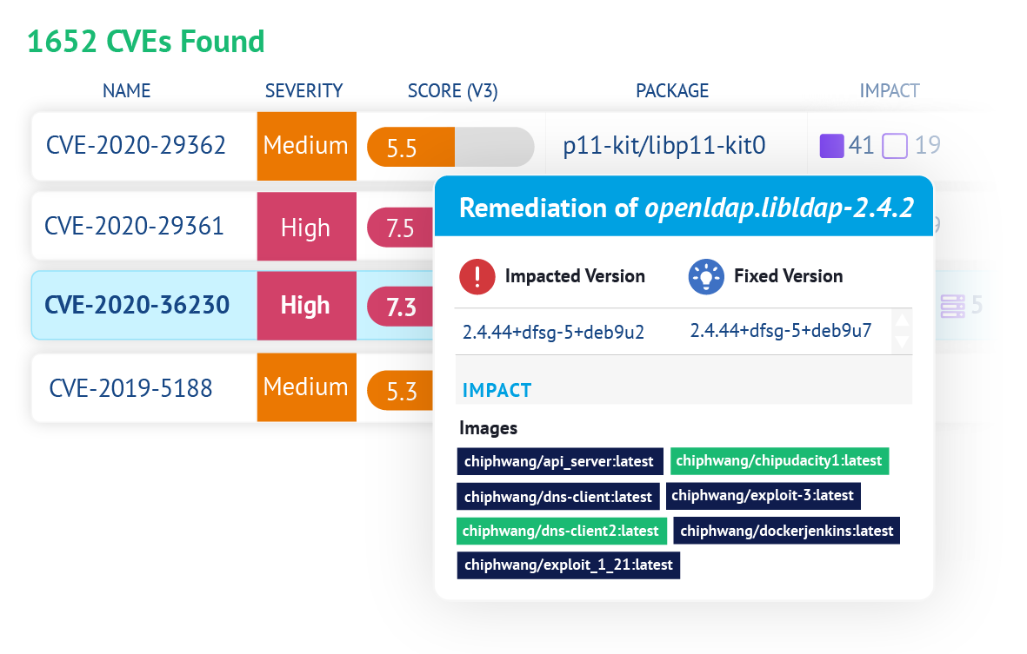
Prevent vulnerable & non-compliant images from deploying.
Full lifecycle CVE and compliance scanning in build, registry, and run-time
Automated compliance testing as well as templates for: GDPR, PCI, HIPAA, NIST, etc.
Admission controls to prevent deployment
Prevent the #1 cause of hacks… misconfigurations
Notes:
Vulnerability and Compliance Scanning/Management
Integrates within CI/CD pipelines in order to scan and report CVE vulnerabilities within container images - scans early in the development process (registry/repos) and admission controls can prevent vulnerable images from deploying
Jenkins plug-in to scan during build, monitor images in registries, and run automated tests for security compliance
Scans images and policy compliance against regulatory controls such as PCI, GDPR, HIPAA and NIST
Scanning capability is extremely fast and accurate, maybe fastest in the industry

Slide 43
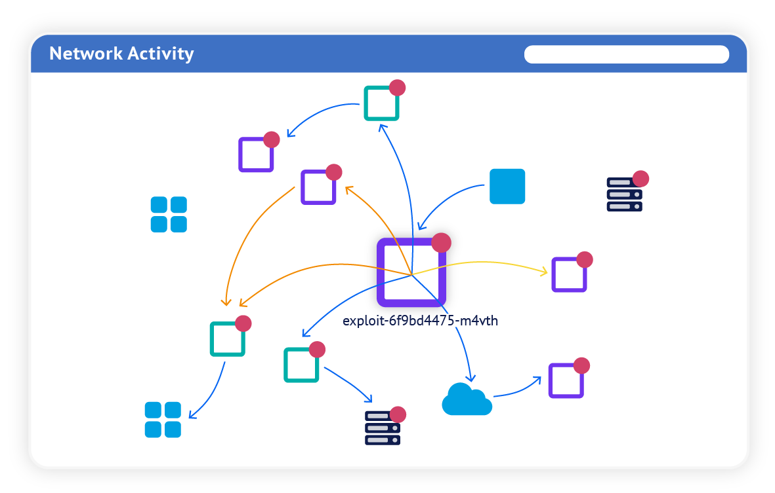
Behavior-based run-time incident detection & prevention
See everything that’s happening on your container network— visualization of containers, connections, violations, threats — in real-time
Automatically inspect and learn all network traffic at Layer 7 and all processes on every container
Deep packet inspection (DPI) to implement Data Loss Prevention (DLP), DDoS & DNS attack detection and prevention, SQL injection, etc.
Automated behavioral learning to build and enforce security policy (security-as-code)
Notes:
Behavioral scanning (run-time/network protection)
Tracks and learns the behavior of your containers and their processes
Protects deployed/running containers by scanning containers, hosts, and orchestration platforms during run-time
Leverages advanced networking protection (deep packet inspection) to identify and block network packet and zero-day and application attacks like DDoS and DNS, in real-time
Uses behavioral learning and proprietary technology to automatically build security policies

Slide 44
Demo

Slide 46
Runtime Container Security Comparison
 | NeuVector | Twistlock | Aqua | Snyk
Inspect Network Packets with Layer 7 Deep Packet Inspection (DPI) | ✅ | ❌ | ❌ | ❌
Auto-learning, Behavioral analysis created Network policy | ✅ | Not for L7 analysis | Not for L7 Analysis | ❌
Threat Detection – distributed network and application attacks, e.g DDoS, DNS | ✅ | ❌ | ❌ Limited-edge WAF | ❌
Data Breach Detection, e.g. DLP, DNS/ICMP tunneling | ✅ | ❌ | ❌ | ❌
Control ingress/egress to external (non-container) services incl by DNS name | ✅ | ❌ | ❌ | ❌
Monitor critical system containers (etcd, API server...) for network attacks | ✅ | ❌ | ❌ | ❌
Detect Privilege Escalations, reverse shell, port scan in host/containers | ✅ | ✅ | ✅ | ❌
Monitor host and container processes, capture history, file system activity, & block suspicious | ✅ | ✅ | ✅ | ❌
Auto scan any container that starts running for vulnerabilities | ✅ | ❌ | ❌ | ❌
Controls: Block connections without impacting container, Quarantine container | ✅ | ❌ | IPtables based, not packet filtering | ❌
Service Mesh integration to inspect packets even encrypted – Istio, Linkerd | ✅ | ❌ | ❌ | ❌
Network session capture and logging, packet capture, auto packet capture on threats, with real-time display | ✅ | ❌ | ❌ | ❌
Container Visualization / Map | ✅ | ❌ | ❌ | ❌
Threat feeds & malware scans | On Roadmap | ✅ | ✅ | ❌
Custom response rules | ✅ | Limited (no network) | Limited (no network) | ❌
Notes:
For more detail https://drive.google.com/file/d/1fxCLxh2d7tA_M80_3qJY12do05oH9Fz1/view?usp=sharing

Slide 47
Nexus Lift – coming soon
for

Slide 48
Lifecycle Products 2021 Roadmap
2021 Q1
2021 Q2
2021 Q3-4
Ecosystems UX
Consistent Nexus Experience - Lifecycle
Focus on Developers
Advanced Development Pack
Transitive Solver Pull Requests
Breaking API Changes GA
Component Choice
Release Integrity for Firewall
Priority Concepts
Advanced Legal Pack
InnerSource Insights
Drive to
Fixing
Identify and Associate Risk
Reduce Duplicate Noise
Remediation
Non-Maven Ecosystems Support
Research and Remediate Foundation
Component Details
Remediation Strategies and Recommendations UX
Transitive Dependency Visualization
Application Details
Waivers Enhancements
IQ UI React Migration
Tech Roadmap
Unified Data Platform
Repository Aware Components

Slide 49
CODI 2021 Roadmap
2021 Q1
2021 Q2
2021 Q3-4
Cloud Year One
Journey to the cloud
Lift - Azure DevOps
Managed Lifecycle
Lift Platform Launch
Bottoms up PQL Central Experience
Developer First Security Partnerships
Strategic Integrations
Nexus Container
Nexus IaC Pack
Priority Concepts
Fortify Partnership
Rapidly Show Value
Onboarding Through Development
Onboard and Evaluate Source Control Repos
New Remediation Strategies
Complete Major Ecosystem Support for SCM

Slide 50
Repository 2021 Roadmap
2021 Q1
2021 Q2
2021 Q3-4
Scale the enterprise
Geo Replication (128 dev weeks)
S3, Filestore Beta
S3, Filestore MVP
Azure/GCP Replication
Priority Concepts
NewDB (280 dev weeks)
NXRM Inclusivity (6 dev weeks)
Tech Roadmap
Phase II Formats
Phase III Formats
All Formats
Notes:
For details, see the NXRM Initiative Pages

Slide 51
1,200 Customers Strong
60 of Fortune 100 | 8 of Top 10 Global Banks | 8 of Top 10 Card Issuers 7 of Top 10 US Tech Firms | 4 of 5 US Armed Forces
Fin Serv
Technology
Media
Manufacturing
Energy
Notes:
We’re been working with most of the Fortune 500 companies’ and global organisations to increase the speed of innovation while reducing risk by automating processes around Open Source.
We are a leader with over 1,000 enterprise customers and is trusted by over 10 million software developers.

