Slide 1
DevSecOps Reference Architectures 2020
Derek E. Weeks
VP and DevOps Advocate
Sonatype

Slide 2
The reference architectures can be used to validate choices you have made or are planning to make.
They are curated from the community. You will notice a number of common elements that are used repeatedly.
Each image has a link to its original source in the speaker notes, enabling you to deep dive for more knowledge.
About this collection
If you would like to have your reference architecture added to this deck, please send it to community@sonatype.com.
Notes:
DevSecOps Reference Architectures can be used to validate choices you have made or are planning to make.

Slide 3
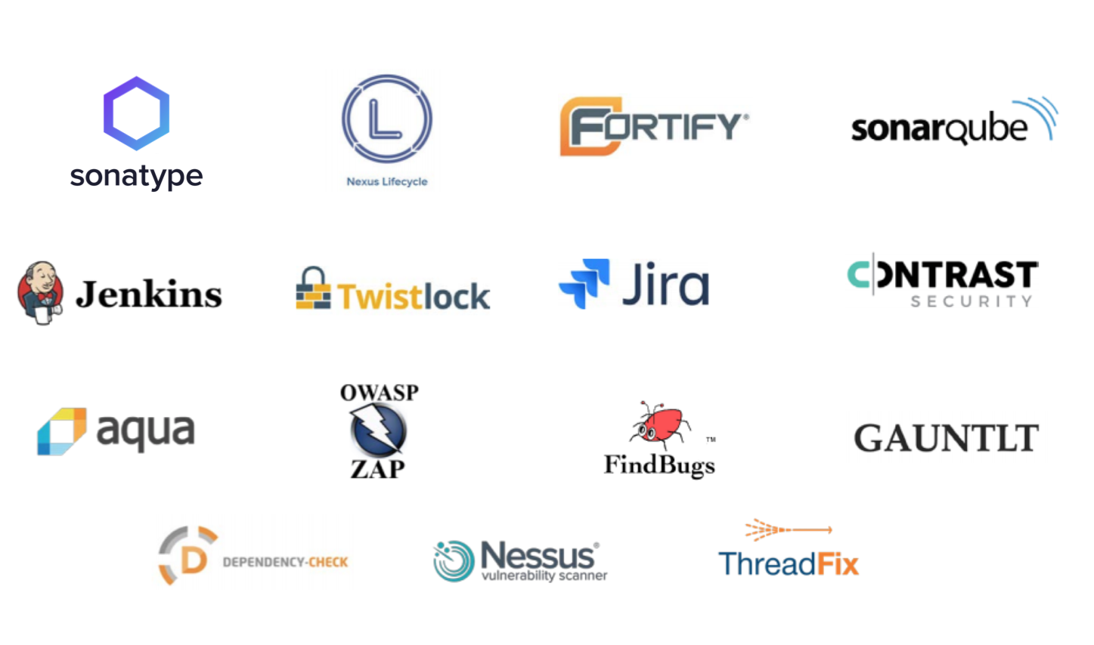
Common Elements of DevSecOps Pipeline
Notes:
Common Elements of a DevSecOps Pipeline include: Sonatype, Sonatype Nexus Lifecycle, Fortify, SonarQube, Jenkins, Twistlock, Jira, Contrast Security, Aqua, OWASP ZAP, FindBugs, Gautlt, Dependency Check, Nessus Vulnerability Scanner, Nexus Vulnerability Scanner, ThreadFix, DevSecOps, Jira, mingle, visual studio, asana, pivotaltracker, Trello, Basecamp, slack, hipchat, #IRC, flowdock, rocketchat, nestor, Microsoft teams, rocket.chat, github pages, confluence, read the docs, hugo, api blueprint, raml, reddit, flarum, open api, iscourse, git, gitlab, gutbucket, mercurial, snap, Jenkins, bamboo, teamcity, wrecker, drone.io, circleci, go, codeship, travis ci, gradle, sbt, grunt, maven central, packer, msbuild, rake, leiningen, dbmaestro, dbemploy, flocker, redgate, flocker, liqui-base, selenium, jasmine, owasp zap, gatling, gautlt, j unit, karma, n unit, fitnesse, qunit, test ng, cucumber, galen framework, .js, loadimpact, jmeter, blazemeter, pytest, serverspec, browsersync, newman, specflow, unit.net, octopus deploy, Xebia labs, rundeck, urban code,juju, spinnaker, ssh, nolio, elasticbox, puppet, chef, ansible, cf engine, saltstack, vagrant, terraform, powershell dsc, docker, quay, jfrog artifactory, python, sonatype nexus, sonatype nexus firewall, sonatype nexus repository, sonatype nexus auditor, archiva, npm, bower, amazon web services, dokku, Flynn, Heroku, rockspace, appfod, openshift, openstack, google cloud platform, deis, mesosphere, kubernetes, marathon, rancher, nomad, mesos, logstash, elasticsearch, datadog, splunk, app dynamics, new relic, google analytics, Prometheus, sentry, sensu, atlas, pagerduty, ops genie, keen IQ, rollbar, statsd, runscope, Api metrics, Dynatrace, airbrake.io, pinpoint, selenium

Slide 4
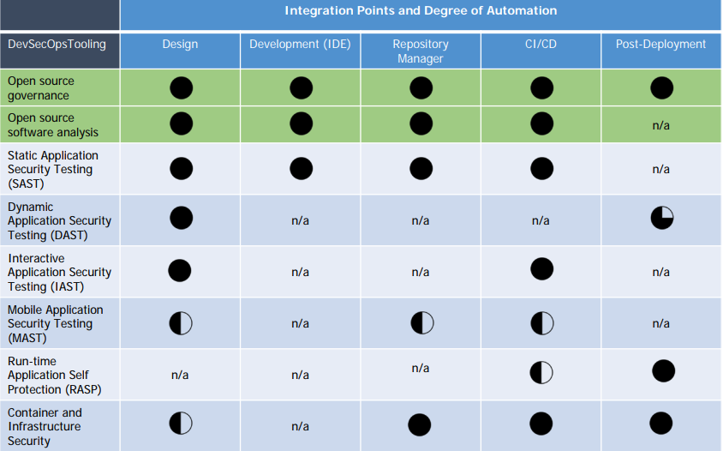
Degrees of DevSecOps Automation
Source: Gartner, December 2017 - “Structuring Application Security Practices and Tools to Support DevOps and DevSecOps”
Notes:
Degrees of DevSecOps Automation (Gartner) include: tooling, open source governance, open source software analysis, static application security test (SAST), dynamic application security testing (DAST), interactive application security testing (IAST), mobile application security testing (MAST), run-time application self protection (RASP), container and infrastructure security

Slide 5
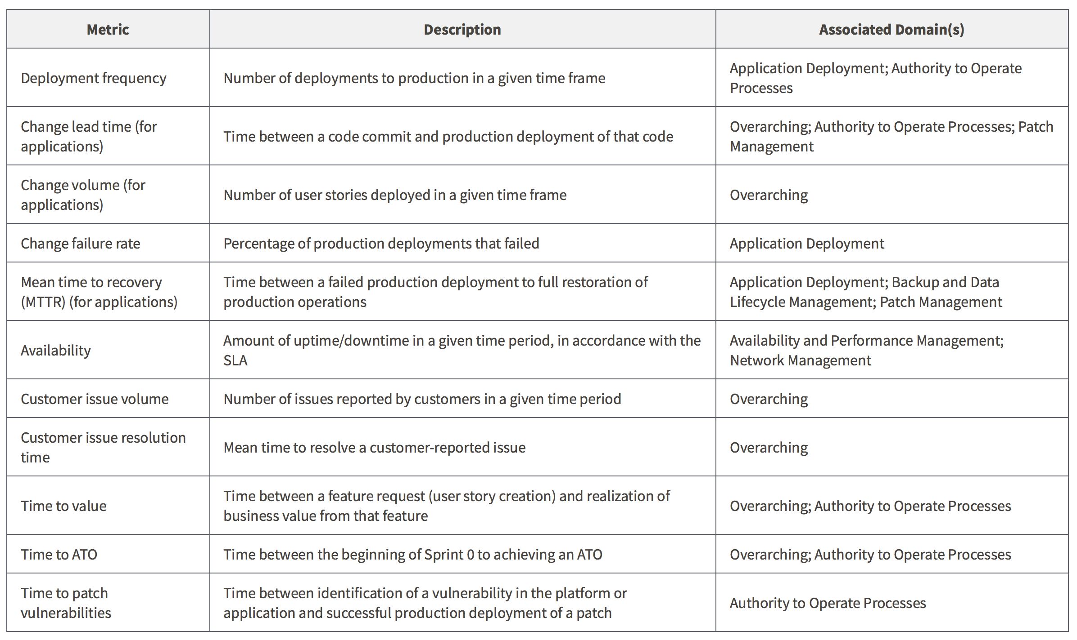
GSA’s DevSecOps Maturity Model
Source: GSA, “DevSecOps Guide”
Notes:
GSA’s DevSecOps Maturity Model

Slide 6
DevSecOps according to
E-SPIN
Notes:
https://www.google.com/url?sa=i&rct=j&q=&esrc=s&source=images&cd=&cad=rja&uact=8&ved=2ahUKEwiC4dzOn5HhAhWumeAKHTqqC7QQjRx6BAgBEAU&url=https%3A%2F%2Fwww.e-spincorp.com%2Ffrom-devops-shift-left-testing-to-devsecops-shift-left-security%2F&psig=AOvVaw0IzFgXsu8S_zqk8k0dH8Uj&ust=1553184150607135

Slide 7
DevSecOps according to
DJ Schleen at Sonatype
https://www.sonatype.com/referencearchitecturetestdrive
Notes:
https://www.sonatype.com/referencearchitecturetestdrive

Slide 8
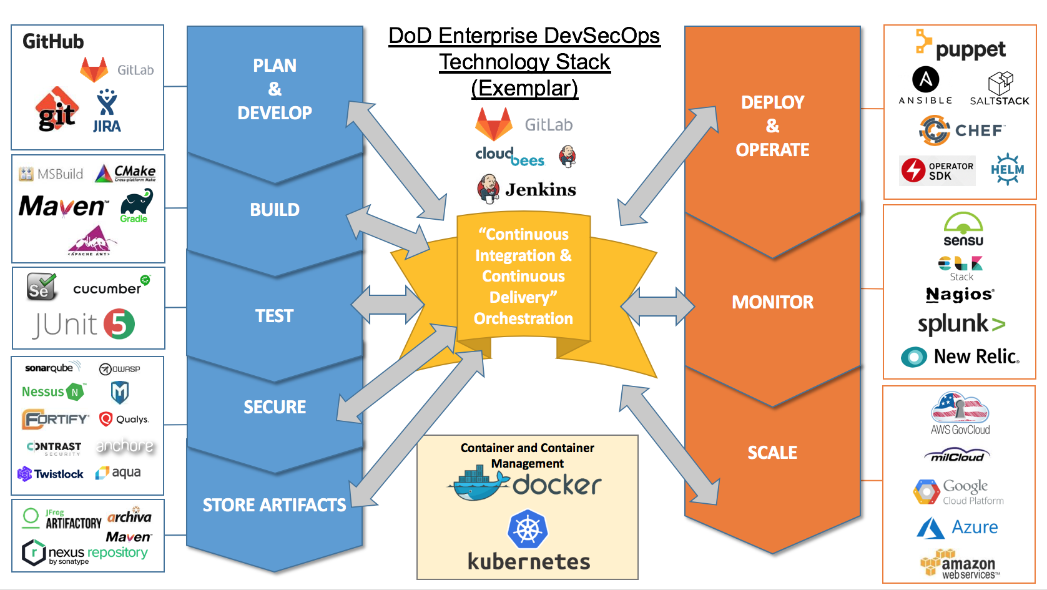
DevSecOps according to Nicolas Chaillan and U.S. Dept of Defense
Notes:
DevSecOps according to Nicolas Chaillan and U.S. Dept of Defense

Slide 9
DevSecOps according to Nicolas Chaillan and U.S. Dept of Defense
Notes:
DevSecOps according to Nicolas Chaillan and U.S. Dept of Defense

Slide 10
DevSecOps according to Nicolas Chaillan and U.S. Dept of Defense
Notes:
DevSecOps according to Nicolas Chaillan and U.S. Dept of Defense

Slide 11
DevSecOps according to Aaron Weaver
Notes:
https://www.google.com/url?sa=i&rct=j&q=&esrc=s&source=images&cd=&cad=rja&uact=8&ved=2ahUKEwjDrZf5oJHhAhXhUN8KHai1CNoQjRx6BAgBEAU&url=https%3A%2F%2Fwww.owasp.org%2Findex.php%2FOWASP_AppSec_Pipeline&psig=AOvVaw03caT3XYAFU2ZKnbh-FL6o&ust=1553189608612941

Slide 12
DevSecOps according to Murray Goldschmidt and Sense of Security
Source: ADDO 2017, YouTube – “DevOps: A How-To for Agility with Security: Murray Goldschmidt”
Notes:
DevSecOps according to Murray Goldschmidt and Sense of Security (All Day DevOps)

Slide 13
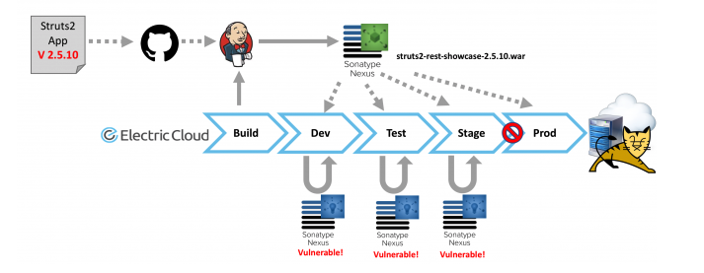
DevSecOps according to Hans Ashlock and Electric Cloud
Source: Hans Ashlock, Electric Cloud – “DevSecOps: How to Build Secure Pipelines and Prevent the Next Equifax”
Notes:
DevSecOps according to Hans Ashlock and Electric Cloud

Slide 14
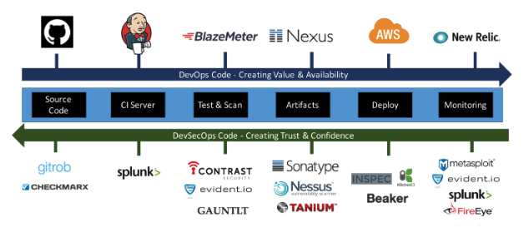
DevSecOps according to Shannon Lietz and Intuit
Source: Shannon Lietz, DevSecOps – “← Shifting Security to the Left”
Notes:
DevSecOps according to Shannon Lietz and Intuit

Slide 15
DevSecOps according to John Willis and Botchagalupe Technologies
Source: John Willis, LinkedIn Slideshare – “You Build It – Cyber Chicago Keynote”
Notes:
DevSecOps according to John Willis and Botchagalupe Technologies

Slide 16
DevSecOps according to Michael Man
Source: Michael Man, LinkedIn SlideShare – “DevSecOps – London Gathering: June 2018”
Notes:
DevSecOps according to Michael Man

Slide 17
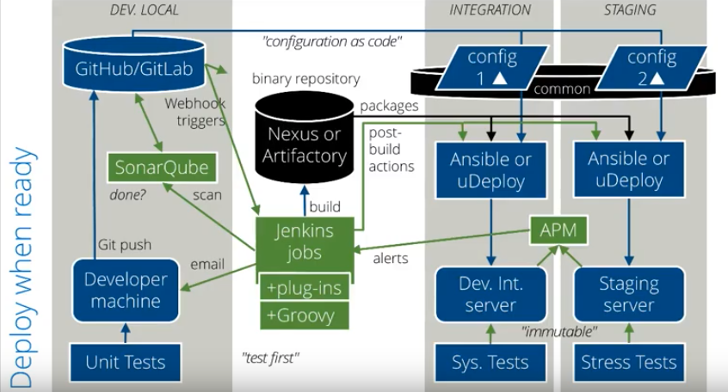
DevSecOps according to Wilson Mar and JetBloom
Source: Wilson Mar – Hands-On DevSecOps Course
Notes:
DevSecOps according to Wilson Mar and JetBloom

Slide 18
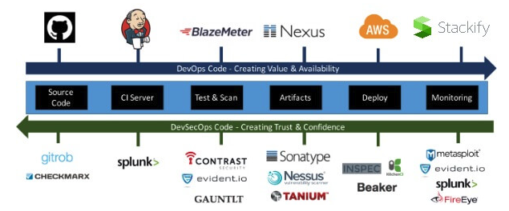
DevSecOps according to Matt Watson and Stackify
Source: Matt Watson – “What is DevSecOps? How to Automate Security Testing”
Notes:
DevSecOps according to Matt Watson and Stackify

Slide 19
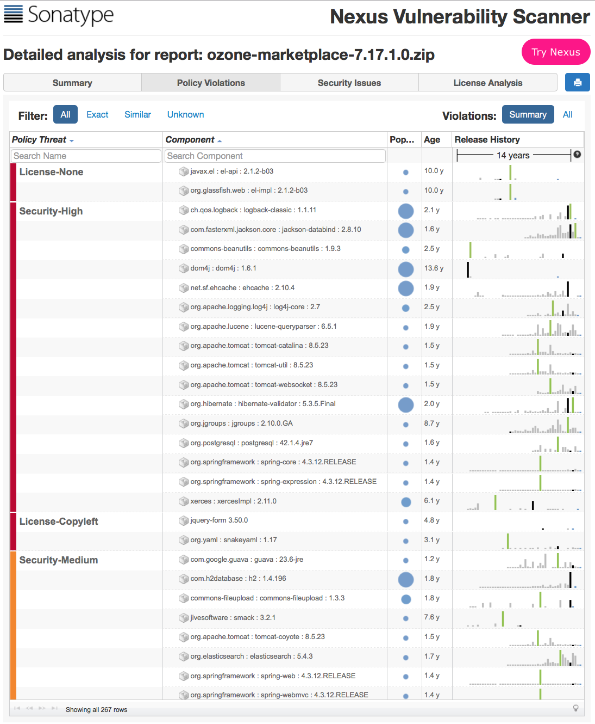
Interested in DevSecOps, but don’t know where to start?
Try Nexus Vulnerability Scanner:
Confidently and quickly analyze your open source and third party components
Create a precise “Bill of Materials” to identify which open source components are used and where.
Discover all component dependencies and known vulnerabilities or license risks.
Notes:
Sonatype Nexus Vulnerability Scanner allows you to confidently and quickly analyze your open source and third party components. Create a precise Bill of Materials to identify which open source components are used and where. Discover all component dependencies and known vulnerabilities or license risks.

Slide 20
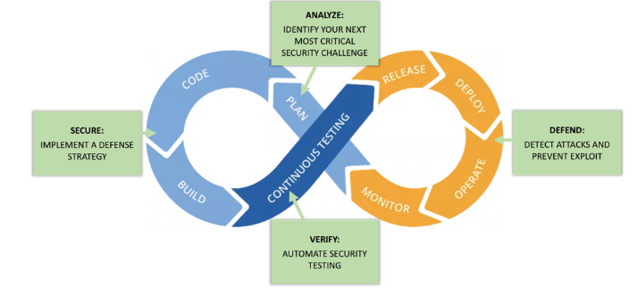
DevSecOps according to Jeff Williams and Contrast Security
Source: Jeff Williams, DZone Refcard #267– “Introduction to DevSecOps”
Notes:
DevSecOps according to Jeff Williams and Contrast Security

Slide 21
DevSecOps according to Tom Porter and HPE/DXC
Source: Tom Porter, DZone – “DevSecOps – A New Chance for Security”
Notes:
DevSecOps according to Tom Porter and HPE/DXC

Slide 22
DevSecOps according to Ben Chicoski and CloudBees
Source: Ben Chicoski, CloudBees – “Orchestrating DevSecOps: Security at Speed”
Notes:
DevSecOps according to Ben Chicoski and CloudBees

Slide 23
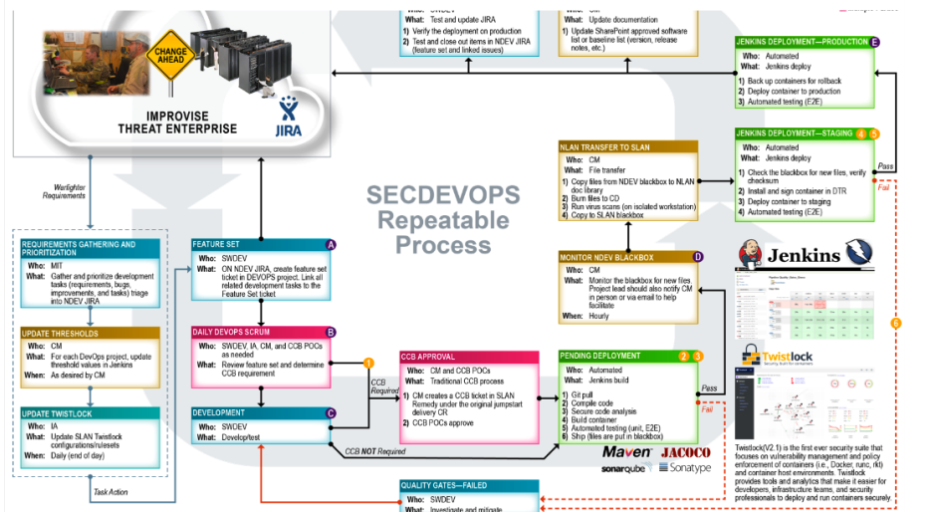
DevSecOps according to Leonel Garciga and U.S. Dept of Defense/JIDO
(circa 2017)
Source: ADDO 2017, YouTube – “Governance and Transparency in GovSec DevOps: Leonel Garciga”
Notes:
DevSecOps according to Leonel Garciga and U.S. Dept of Defense/JIDO (All Day DevOps)

Slide 24
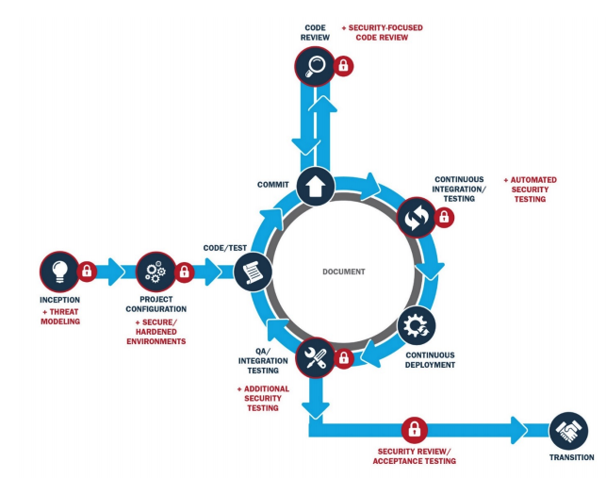
DevSecOps according to Hasan Yasar and Carnegie Mellon SEI
Source: Derek Weeks, DZone – “From Water-Scrum-Fall to DevSecOps”
Notes:
DevSecOps according to Hasan Yasar and Carnegie Mellon SEI

Slide 25
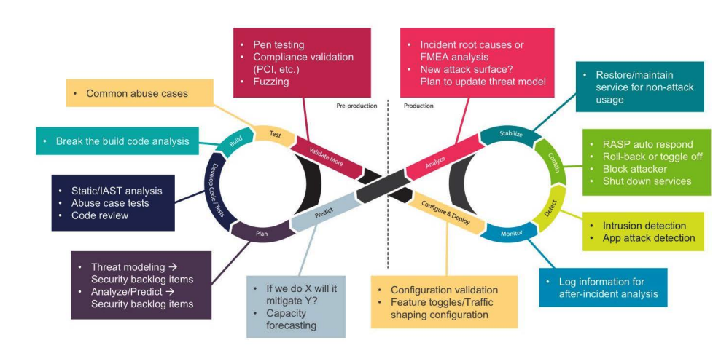
DevSecOps according to Larry Maccherone and Comcast
Source: Larry Maccherone (@Lmaccherone), Twitter – “Annotated DevSecOps Cycle”
Notes:
DevSecOps according to Larry Maccherone and Comcast (All Day DevOps)

Slide 26
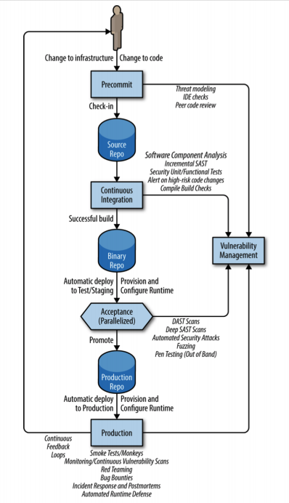
DevSecOps according to Jim Bird
Source: Jim Bird, O’Reilly – “DevOps Sec: Securing Software Through Continuous Delivery”
Notes:
DevSecOps according to Jim Bird

Slide 27
DevSecOps according to
YOU
Want your DevSecOps Reference Architecture to this deck?
Send it to community@sonatype.com with the subject line: DevSecOps Reference Architecture
Provide a link as to where people can find more info about it (e.g., blog, video, SlideShare)
We’ll add it to this deck with full attribution to you
It’s that easy; we all learn with help from the community. Thank you in advance for your contributions!
Notes:
We would love to add your DevSecOps Reference Architecture to this deck.
Send it to community@sonatype.com with the subject line: DevSecOps Reference Architecture or DM us on Twitter @Sonatype
Provide a link as to where people can find more information about the architecture (e.g., your blog, a video, a SlideShare deck)
We’ll add it to this deck with full attribution to you, and let you know that it has been updated.
It’s that easy; we all learn with help from the community. Thank you in advance for your contributions!

Slide 28
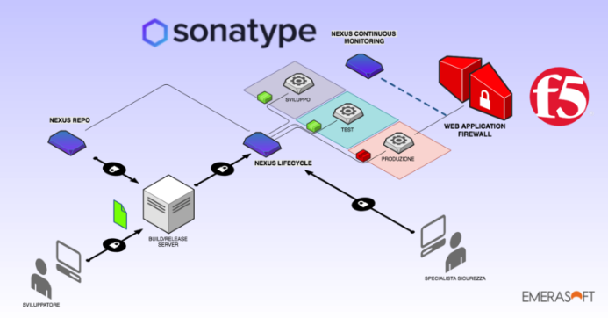
DevSecOps according to Ugo Cirací and Emerasoft
Source: Ugo Cirací, Emerasoft, Medium – “DevSecOps at Emerasoft: Sonatype Nexus Lifecycle and F5-Advanced WAF”
Notes:
DevSecOps according to Ugo Cirací and Emerasoft

Slide 29
DevSecOps according to Ashish Rajan and Versent
Source: Ashish Rajan, Medium – “DevSecOps Melbourne Meetup S01E06 & Event Update”
Notes:
DevSecOps according to Ashish Rajan and Versent

Slide 30
DevSecOps according to Chaitanya Jawale and Opcito
Source: Chaitanya Jawale, Opcito – “From the CEO’s Desk: DevSecOps – Next Stride for DevOps”
Notes:
DevSecOps according to Chaitanya Jawale and Opcito

Slide 31
DevSecOps according to Seth Gagnon and Cigna
Source: Seth Gagnon, Dzone – “An Example of a Continuous Delivery Pipeline”
Notes:
DevSecOps according to Seth Gagnon and Cigna

Slide 32
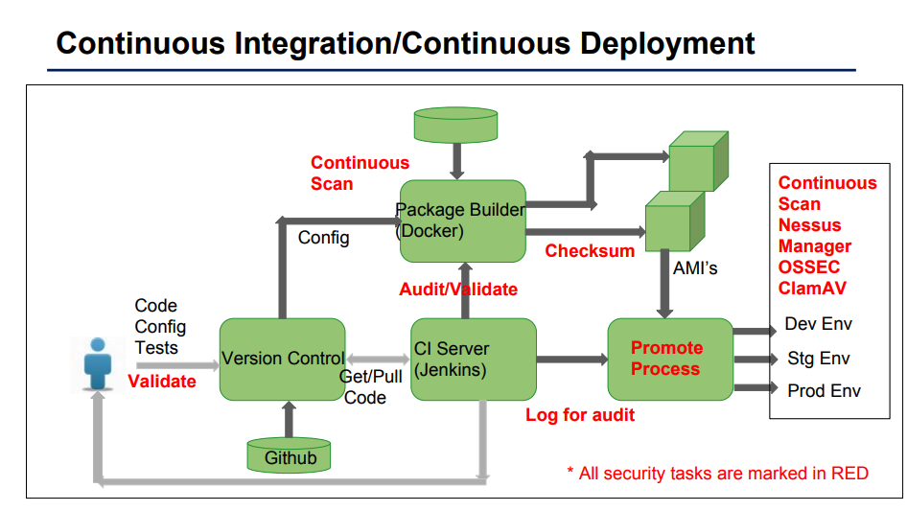
DevSecOps according to GSA
Source: GSA Slidedeck – “Implementation of DevSecOps for D2D”
Notes:
DevSecOps according to GSA

Slide 33
DevSecOps according to Atul Jadhav and Aricent
Source: Atul Jadhav, Aricent – ”Security Software”
Notes:
DevSecOps according to Atul Jadhav and Aricent

Slide 34
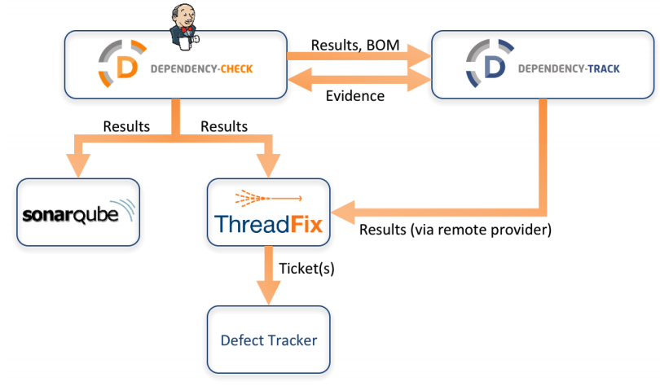
DevSecOps according to Steve Springett and ServiceNow
Source: Steve Springett, GitHub – “Dependency-Track”
Notes:
DevSecOps according to Steve Springett and ServiceNow

Slide 35
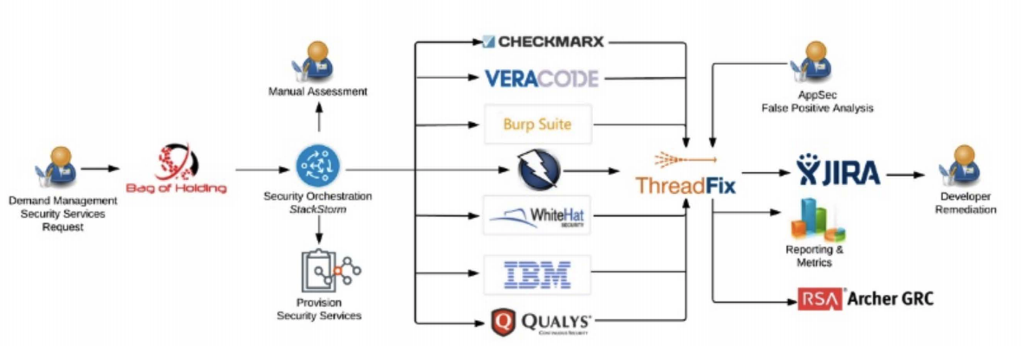
DevSecOps according to Mohammed Imran and TeachEra
Source: Mohammed Imran, LinkedIn – “Practical DevSecOps Course – Part 1”
Notes:
DevSecOps according to Mohammed Imran and TeachEra

Slide 36
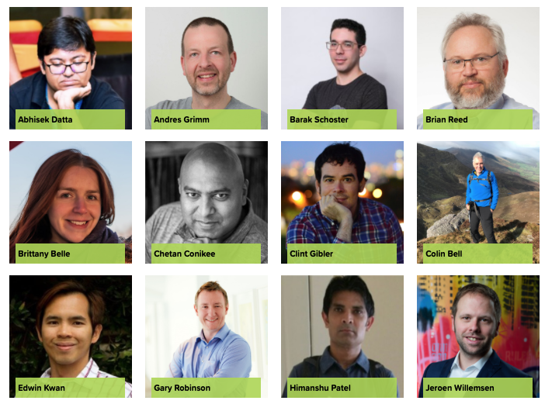
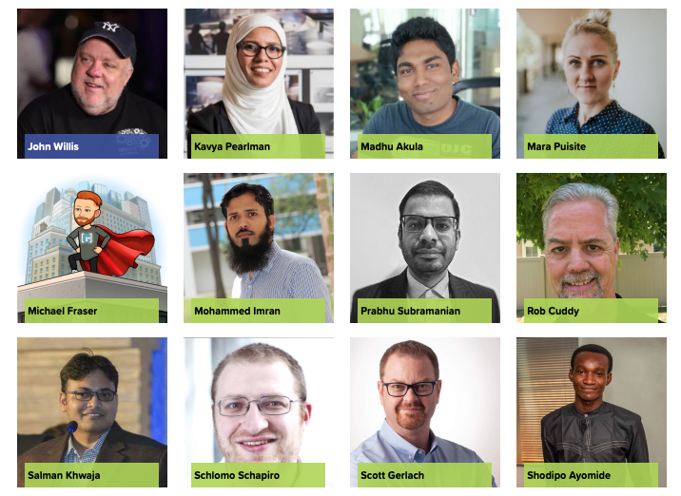
24 DevSecOps practitioners from leading enterprises shared their experiences and best practices. Those recordings are all available for free at www.alldaydevops.com.
Learn More About DevSecOps:
12 Nov 2020
All Day DevOps
Notes:
Learn more from your peers – 27 DevSecOps practitioners from leading enterprises shared their experiences and best practices at All Day DevOps. Those recordings are all available for free at www.alldaydevops.com.

Slide 37
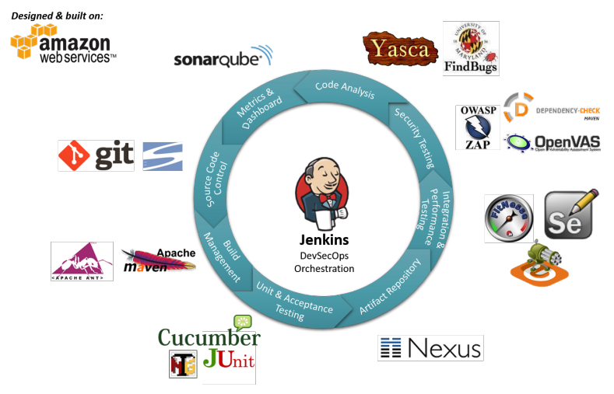
DevSecOps according to Alan Crouch and Coveros
Source: Alan Crouch, Coveros - “Implementing the DevSecOps Process”
Notes:
DevSecOps according to Alan Crouch and Coveros

Slide 38
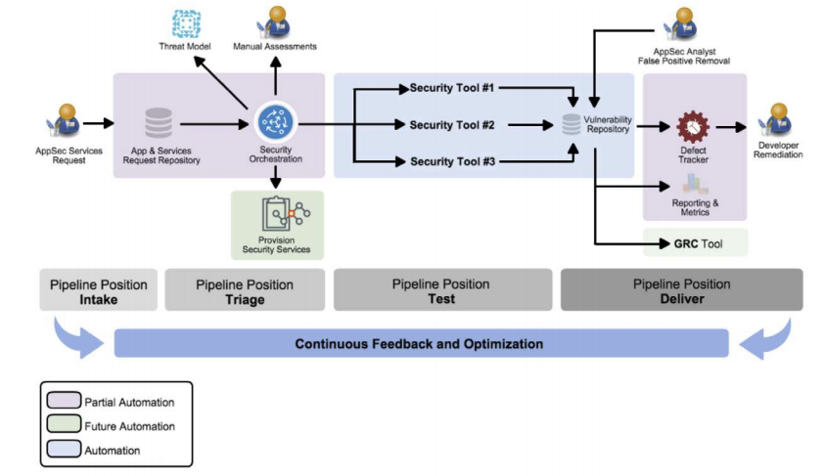
DevSecOps according to Aaron Weaver and Protiviti
Source: Stefan Streichsbier, LinkedIn – “DevSecOps – The Big Picture”
Notes:
DevSecOps according to Aaron Weaver and Protiviti

Slide 39
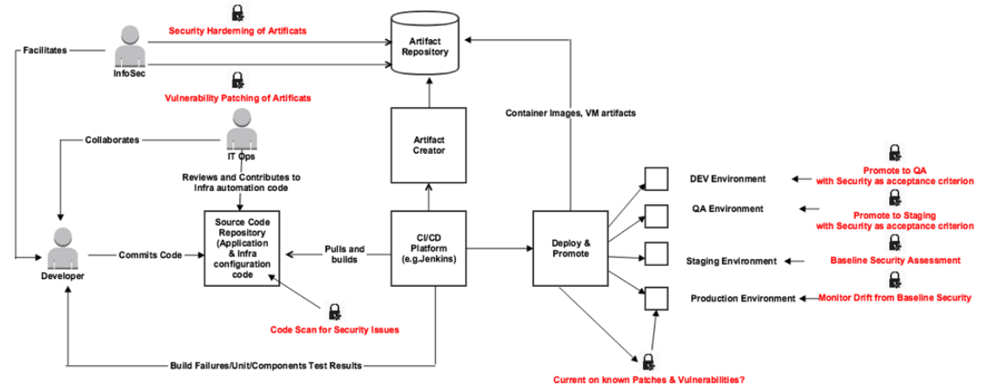
DevSecOps according to Dr. Ravi Rajamiyer
Source: Dr. Ravi Rajamiyer, Medium blog– “When ‘IoC’ Meets ‘SoC’”
Notes:
DevSecOps according to Dr. Ravi Rajamiyer and Cavirin
https://medium.com/@ravirajamiyer_99969/devsecops-when-infrastructure-as-code-meets-security-as-code-2a218ce2381d

Slide 40
DevSecOps according to ACROSEC
Source: Derek Weeks, ACROSEC – “3 Important Elements of Application Security: ‘Shift Left,’ ‘Security by Design,’ and ‘DevSecOps’”
Notes:
DevSecOps according to ACROSEC

Slide 41
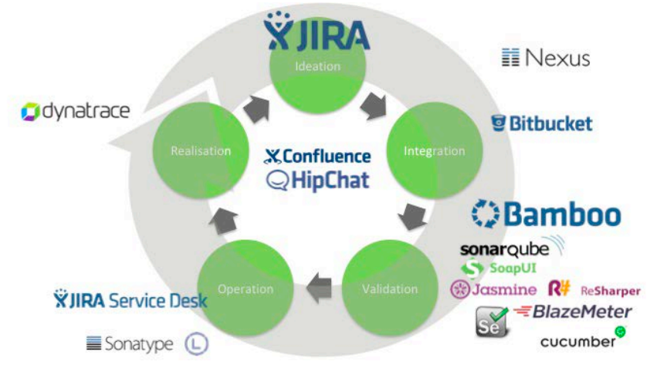
DevSecOps according to Helen Beal and Ranger4
Source: Helen Beal, LinkedIn – “DevSecOps: Is It a Good Thing?”
Notes:
DevSecOps according to Helen Beal and Ranger4

Slide 42
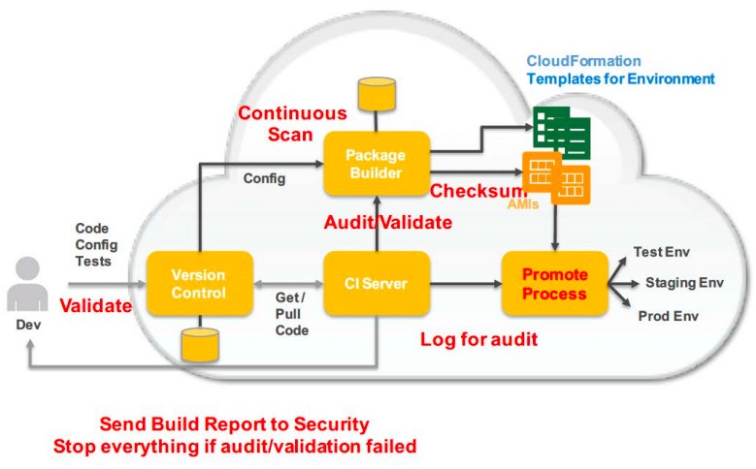
DevSecOps according to Ian Massingham and AWS
@IanMmmm
Source: Ian Massingham (@IanMmmm), LinkedIn– “Securing Systems at Cloud Scale with DevSecOps”
Notes:
DevSecOps according to Ian Massingham and AWS

Slide 43
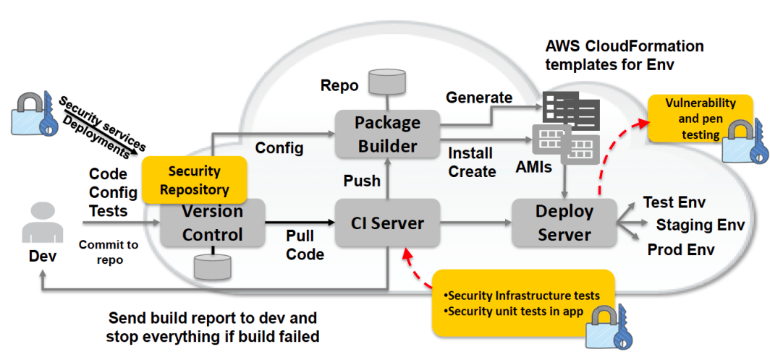
DevSecOps according to Priyanka Aash and AWS
Source: Priyanka Aash, LinkedIn – “DevSecOps in Baby Steps”
Notes:
DevSecOps according to Priyanka Aash and AWS

Slide 44
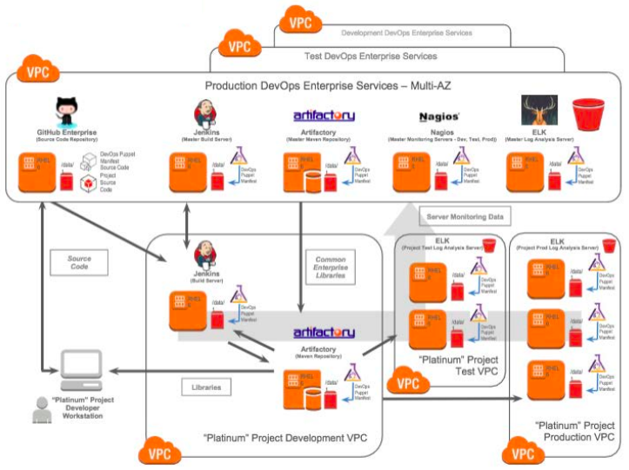
DevSecOps according to Dominic Delmolino and Accenture
Source: ADDO 2017, YouTube – “DevOps in Secure Environments: Strategies for Success: Dominic Delmolino”
Notes:
DevSecOps according to Dominic Delmolino and Accenture (All Day DevOps)

Slide 45
DevSecOps according to Archie Gunasekara and Shine Solutions
Source: Archie Gunasekara, Shine Solutions – “The Emergence of the 3 Towers: DevSecOps”
Notes:
DevSecOps according to Archie Gunasekara and Shine Solutions

Slide 46
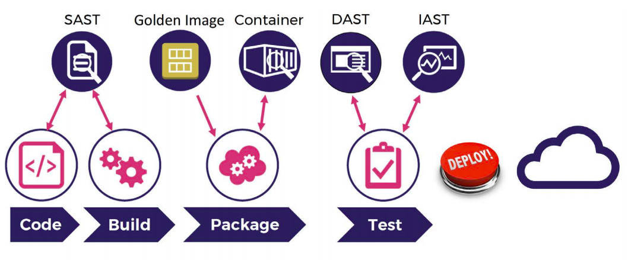
DevSecOps according to Mohammed Imran and Ellucian
Source: Mohammed Imran, LinkedIn – “Practical DevSecOps Course – Part 1”
Notes:
DevSecOps according to Mohammed Imran and Ellucian

Slide 47
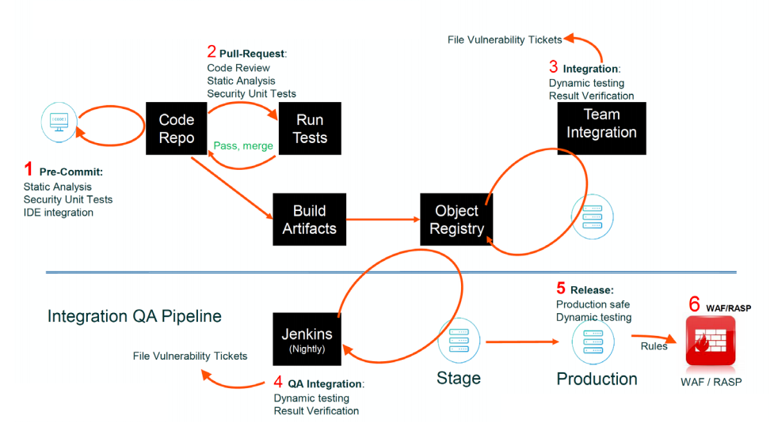
DevSecOps according to Siamak Pazirandeh and WhiteHat Security
Source: WhiteHat Security – ”Take Control: Design a Complete DevOps Program”
Notes:
DevSecOps according to Siamak Pazirandeh and WhiteHat Security

Slide 48
Notes:
www.sonatype.com

